Slide 1


Investor Update
Dec 30, 2025
http://www.delicacy.com.tw

Slide 2
Disclaimer
The information contained in this presentation, including all forward-looking information, is subject to change without notice, whether as a result of new information, future events or otherwise, and De Licacy Co., Ltd. (the “Company”) undertakes no obligation to update or revise the information contained in this presentation. No representation or warranty, either expressed or implied, is provided in relation to the accuracy, completeness or reliability of the information contained herein, nor is the information intended to be a complete statement of the Company, markets or developments referred to in this presentation.

Slide 3
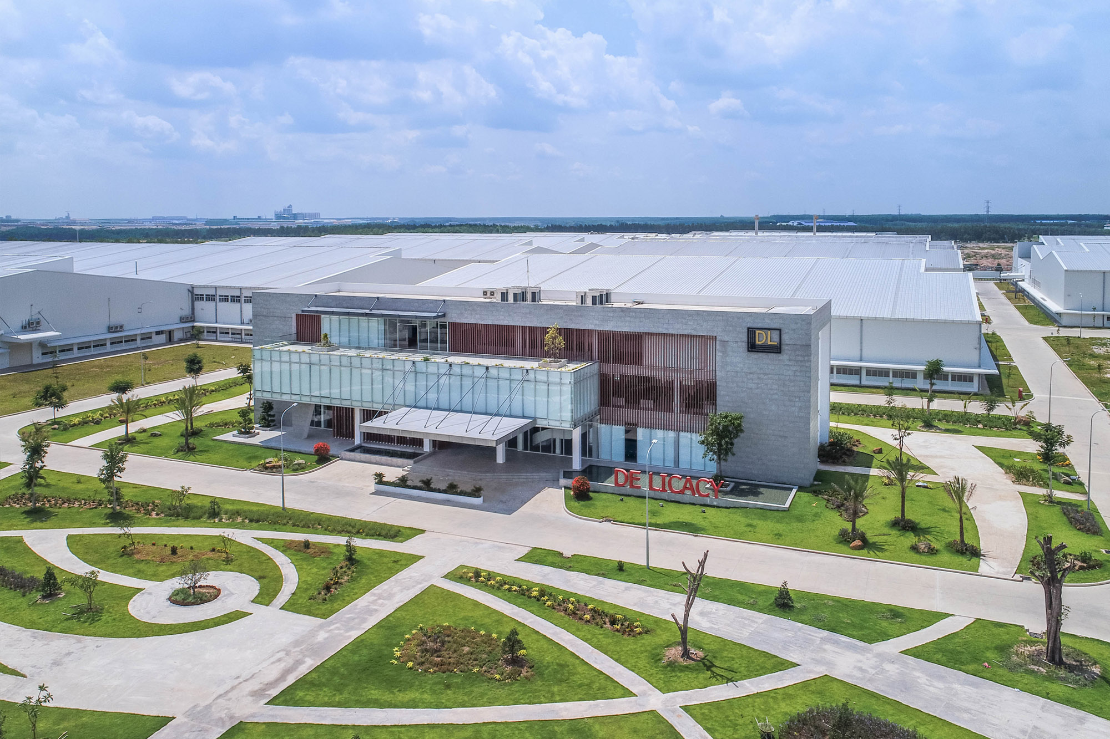
OUTLINE
About De Licacy
Products
Financial Performance
Garment R&D Center
Relocation Compensation
Global capacity restructuring strategy in response to industrial changes
Partnership

Slide 4
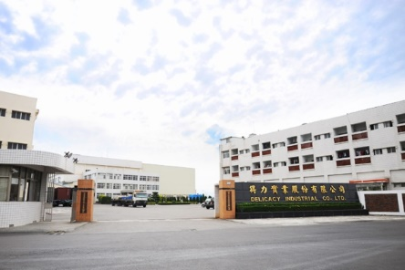
ABOUT DE LICACY
Products
Financial Performance
Garment R&D Center
Relocation Compensation
Global capacity restructuring strategy in response to industrial changes
Partnership

Slide 5



HISTORY
Established office in Taipei
Established factory in Hangzhou
joined the bluesign®
SYSTEM
1982
1987
1997
1998
1999
2012
Taiwan De Licacy was founded in summer
Shares were traded in Taiwan Stock Market in January
Coating & Lamination extra finishing factory was established

Slide 6

HISTORY
Passed ISO 14001
Environmental Management System Verification
Golden Trade Award for Best Trade Contribution Award
Established Apex (Anqing) TEXTILE CO.,LTD
2014
2017
2018
2021
2022
2023
2025
Established Chadtex Industrial co., Ltd.
Had Lucky Unique
Received GRS certification
Established factory in Nantong
Acquired LUCKY Corporate Groups in January
Paid deposit for Indonesian factory land in October

Slide 7

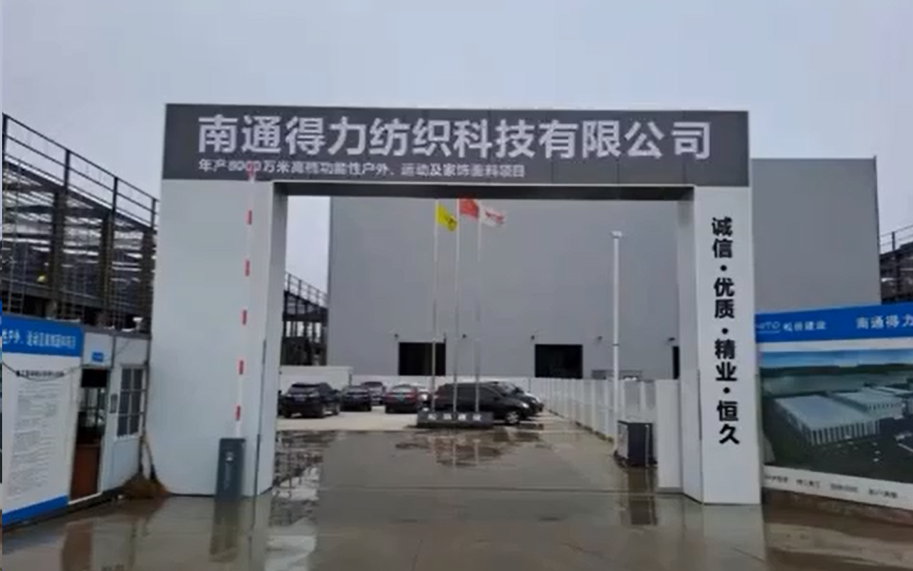
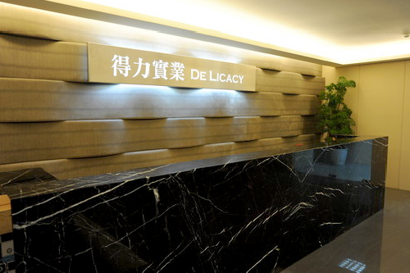
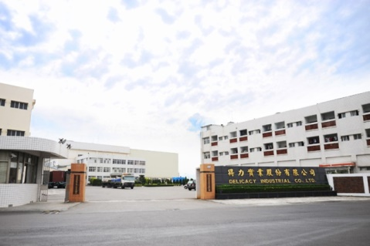
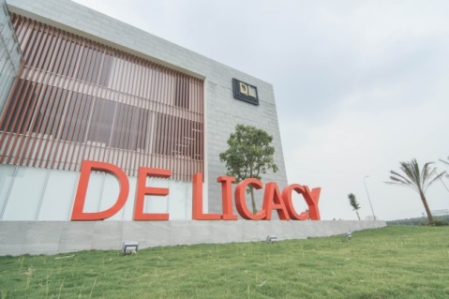
LOCATION
Factory – Jiangsu
CHINA
Sales Office
Factory
Factory – Vietnam De Licacy
Taipei, TAIWAN
Tainan, TAIWAN
Binh Duong Prov., VIETNAM

Slide 8
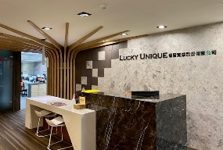
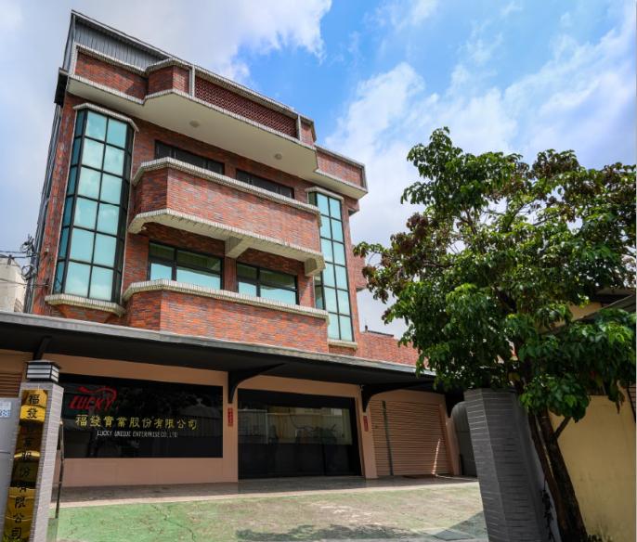
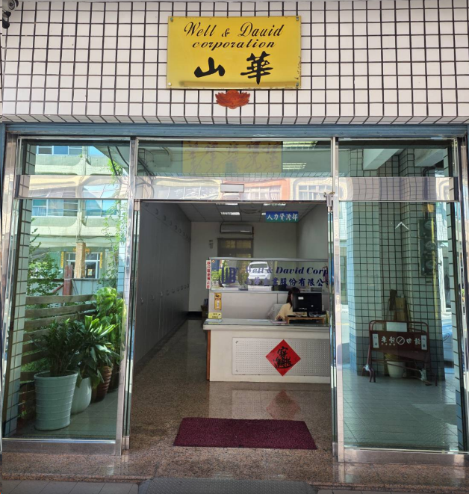
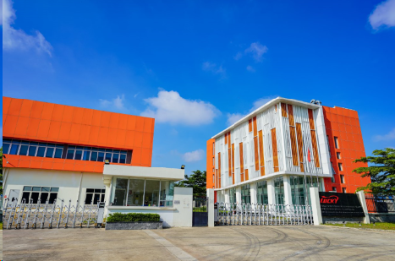
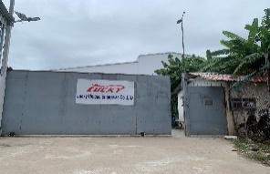
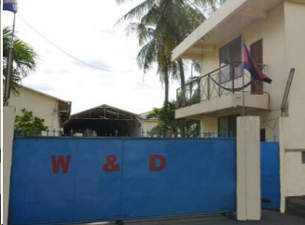
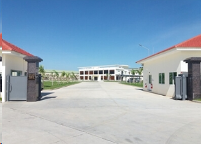
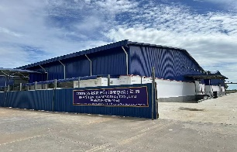
LOCATION
Sales Office
Garment R&D
Center W&D
Garment R&D
Center Tainan
Taipei, TAIWAN
Kaohsiung, TAIWAN
Tainan, TAIWAN
Garment Factory
Lucky VN
Binh Phuoc
Prov.,
VIETNAM
Garment Factory
W&D
Garment Factory
SHANHUA
Garment Factory
Lucky
Garment Factory
Li Qiang
Kandal
Prov.,
Cambodia
Phnom Penh
Prov.,
Cambodia
Kampong Cham Prov.,
Cambodia
Kampong Cham Prov.,
Cambodia

Slide 9
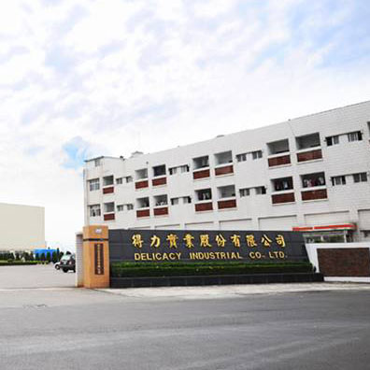
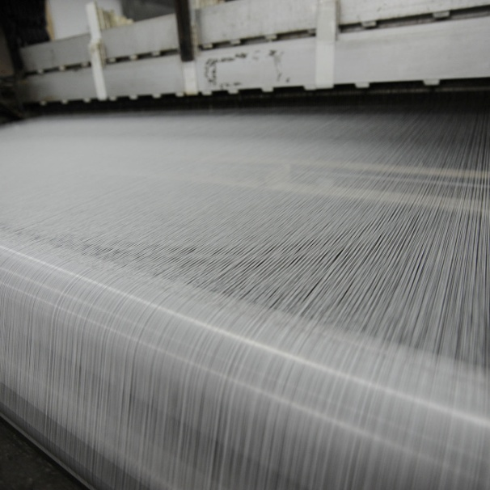
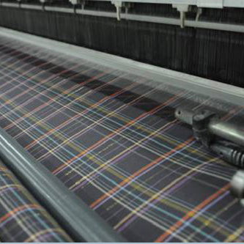
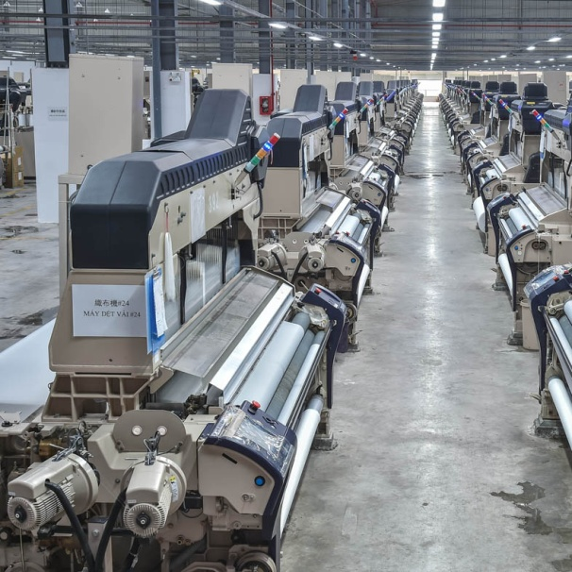
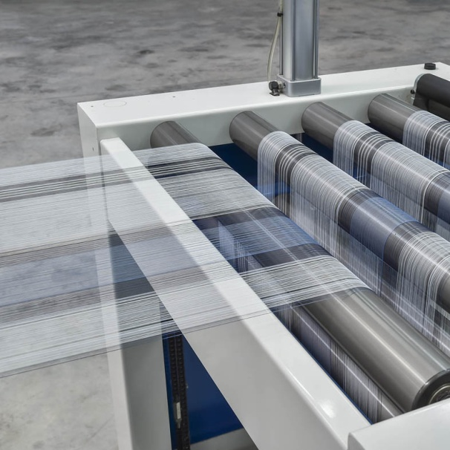
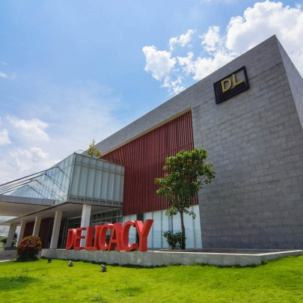
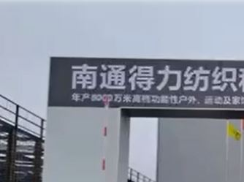
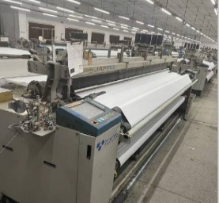
CAPACITY ADJUSTMENT
P/D
2,100,000
yard/month
Y/D
300,000 → 0
yard/month
Tainan
Factory
P/D
5,200,000
yard/month
Y/D
1,200,000
yard/month
Vietnam De Licacy
P/D
2,500,000 yard/month
Nantong
Factory

Slide 10
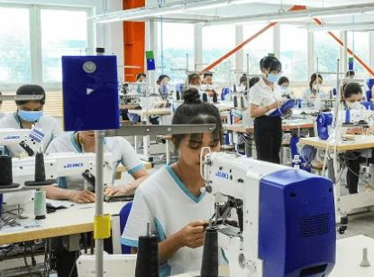
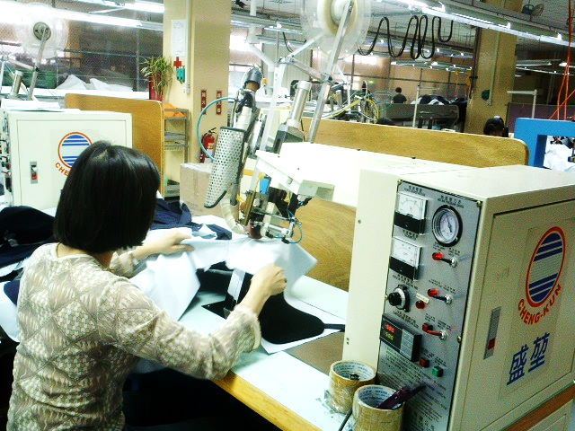
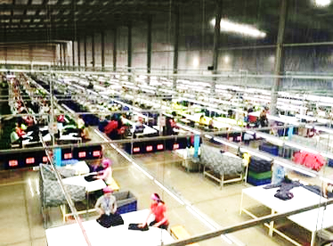
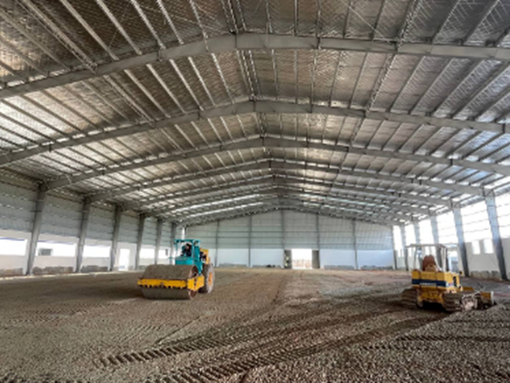
CAPACITY ADJUSTMENT
170,000
pieces/month
20,000 → 0
pieces/month
Factory W&D Cambodia
Factory W&D TW
178,000
pieces/month
100,000
pieces/month
Factory Lucky VN
Factory Li Qiang Cambodia
200,000 (Planned)
pieces/month
120,000
pieces/month
Factory GTA Cambodia
Factory SHANHUA Cambodia
(Construction completed)

Slide 11

About De Licacy
PRODUCTS
Financial Performance
Garment R&D Center
Relocation Compensation
Global capacity restructuring strategy in response to industrial changes
Partnership

Slide 12
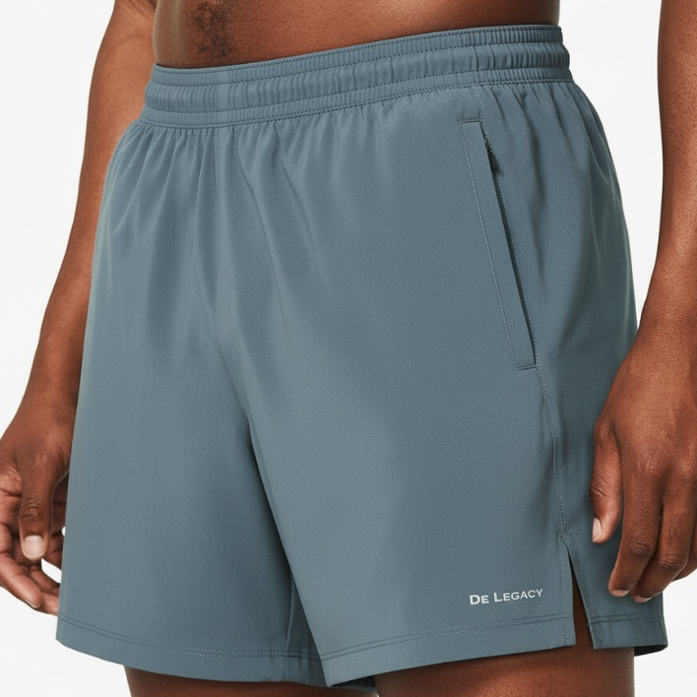
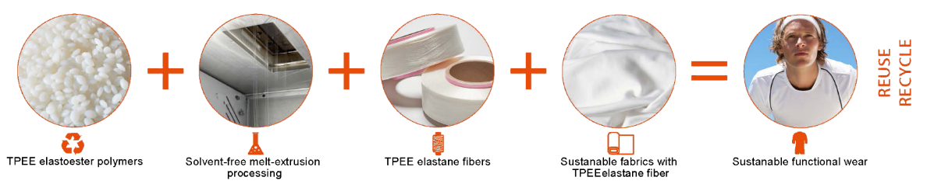
TPEE Elastane Fiber--Thermoplastic Polyester Elastomer
TPEE is designed as an eco-friendly alternative to traditional elastane (spandex). As a kid of polyester-based material, it can be woven with polyester to develop mono-material fabrics, enabling end-of-life product recycling with mono-material constructions, promoting the recycling of old garments and textile waste. Compared to spandex, TPEE is produced through proprietary solvent-free melt spinning process. Additionally, it requires lower heat-setting temperature, providing energy-saving while offering superior stretch, recovery, and maintaining fabric soft handfeel and better color fastness. It can be fully recycled to achieve environmental responsibility.

Slide 13

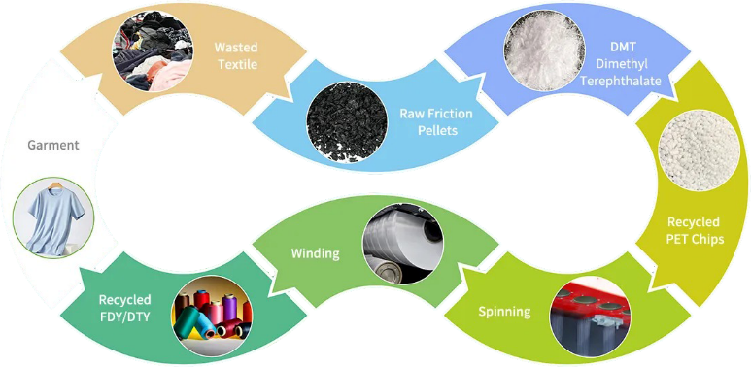
T2T Recycled Polyester from Wasted Textile
T2T recycling transforms waste fabrics into new fabrics and garments, supporting the vision of “textile closed-loop” and achieving circularity. Its advantages include reducing waste, lowering the demand for raw materials, and conserving resources and energy. Furthermore, it minimizes the environmental impact of textiles, promotes a circular economy, and supports the sustainable development of the fashion and textile industries.

Slide 14

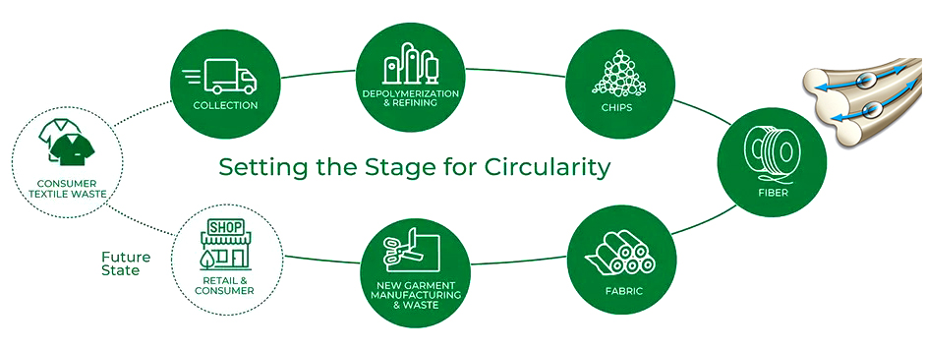
COOLMAX® EcoMade made from 100% Textile Waste
COOLMAX® EcoMade technology merges environmental responsibility with superior function, delivering permanent moisture-wicking performance using 100% recycled resources. Produced entirely from pre-consumer textile waste, these fibers feature a unique engineered cross-section designed to maximize capillary action. This structural innovation ensures rapid moisture transport and quick-dry properties, offering uncompromising high performance in a sustainable package.

Slide 15
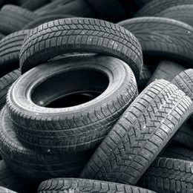
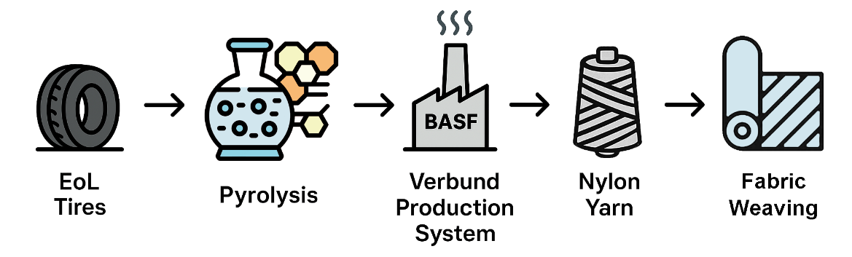
From Waste Tires to Textiles: BASF’s Ccycled ®--Circular Nylon
BASF’s Ccycled® technology innovatively transforms end-of-life tires into regenerated nylon fibers. Through pyrolysis, waste tires are broken down to yield pyrolysis oil, which is then converted into Polyamide 6 (Nylon 6). This recycled polymer delivers physical, mechanical, and processing performance identical to virgin fossil-based nylon, retaining exceptional strength and abrasion resistance. By diverting tires from landfills and incineration, Ccycled® achieves true circularity and significantly reduces reliance on virgin fossil resources.

Slide 16
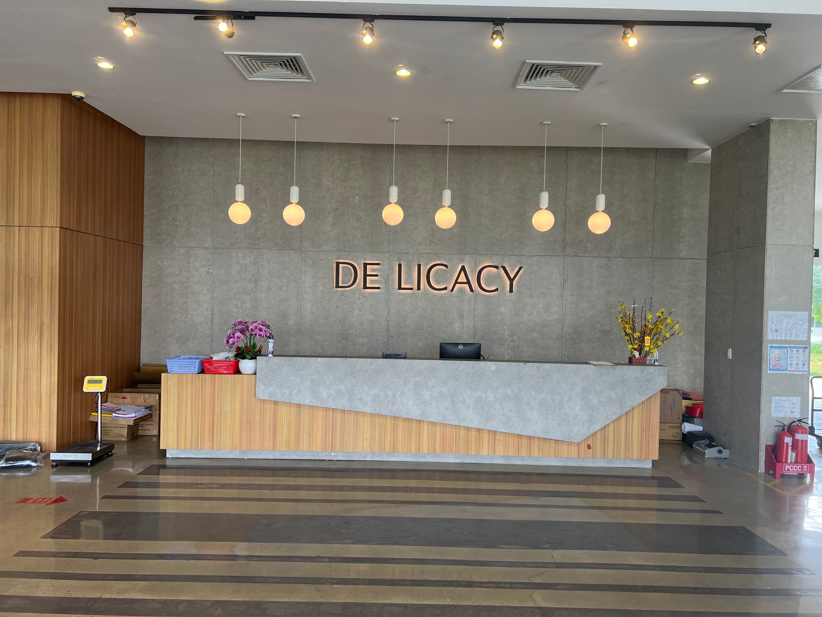
About De Licacy
Products
Financial Performance
Garment R&D Center
Relocation Compensation
Global capacity restructuring strategy in response to industrial changes
Partnership

Slide 17
Profitability
Total Revenue (NT$B)
Net Profit Margin (%)

Slide 18
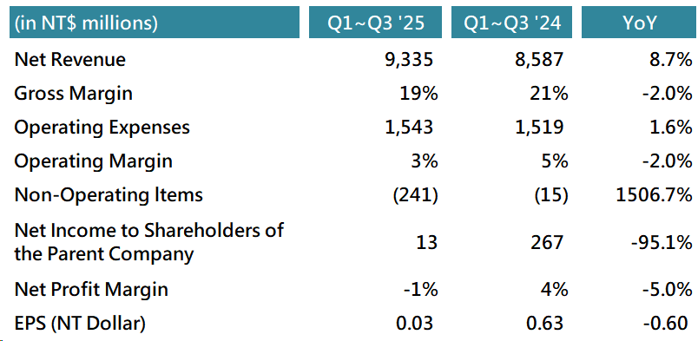
Consolidated P&L

Slide 19
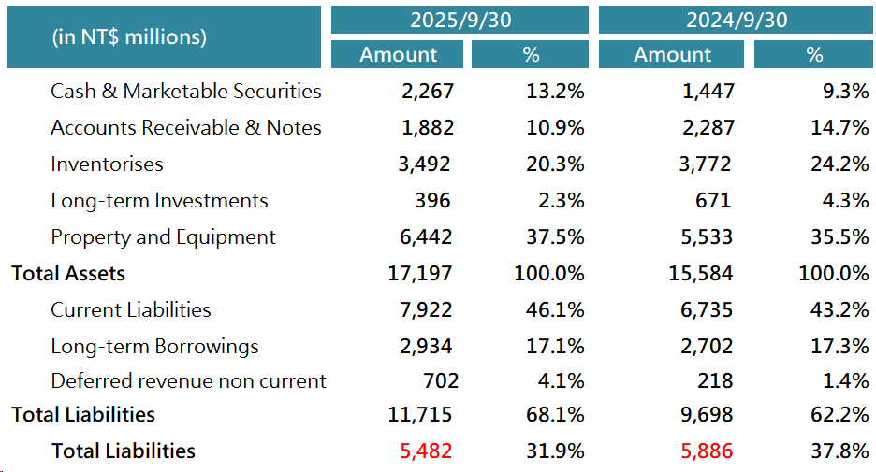
Consolidated Balance Sheets

Slide 20
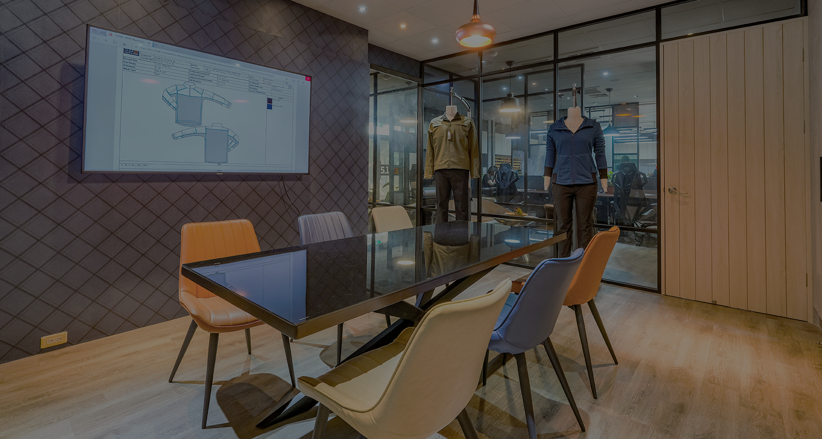
About De Licacy
Products
Financial Performance
Garment R&D Center
Relocation Compensation
Global capacity restructuring strategy in response to industrial changes
Partnership

Slide 21
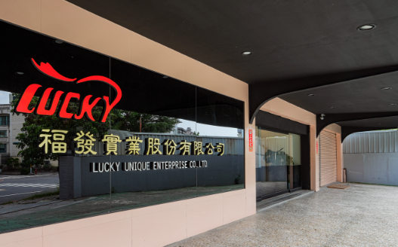
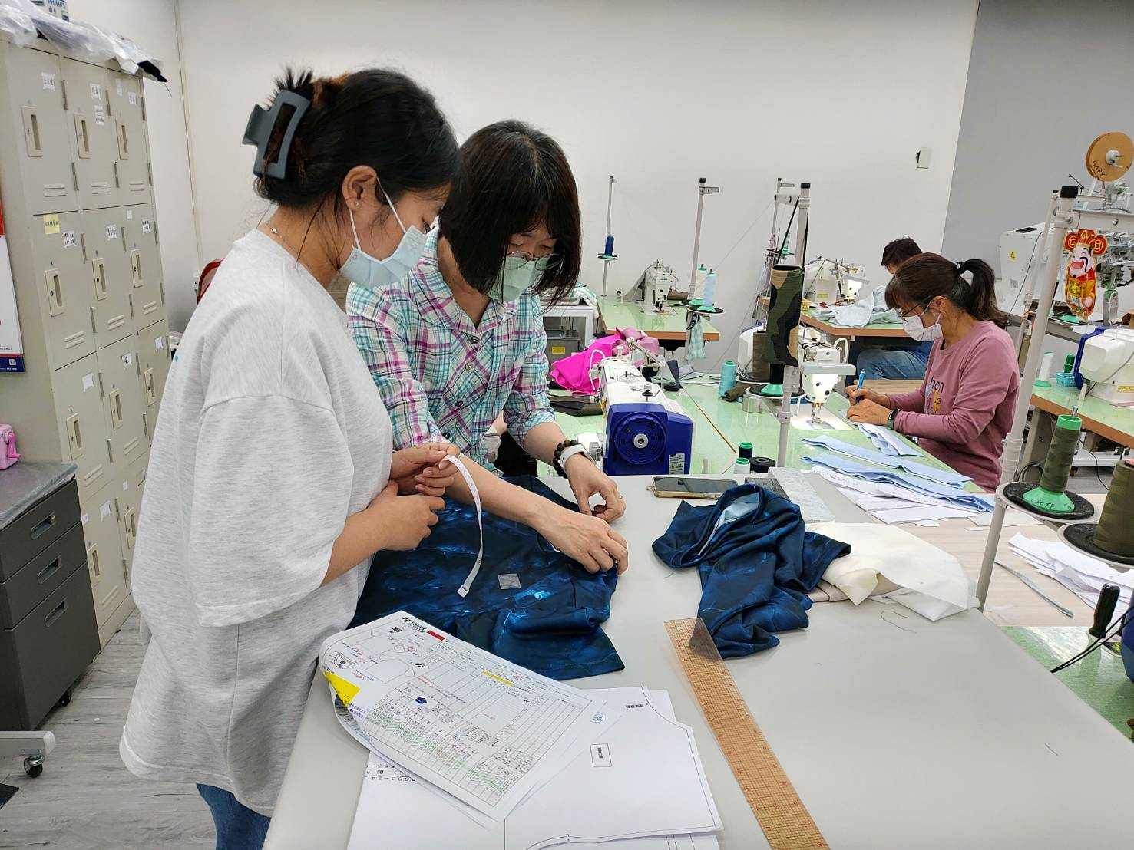
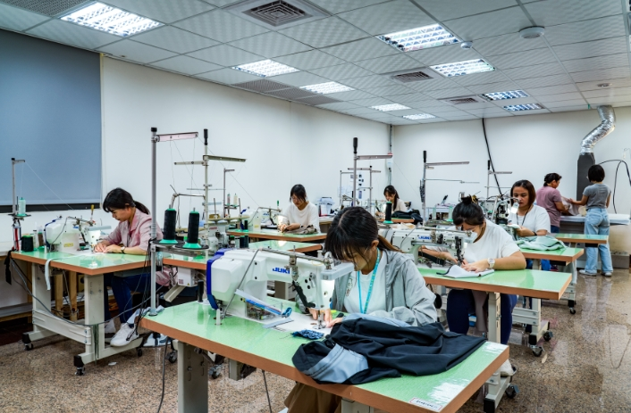
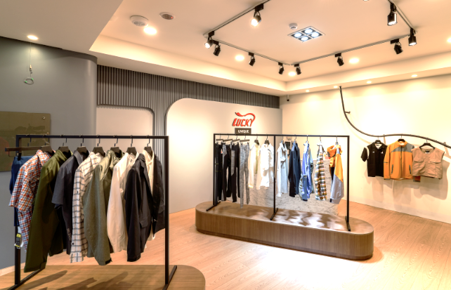
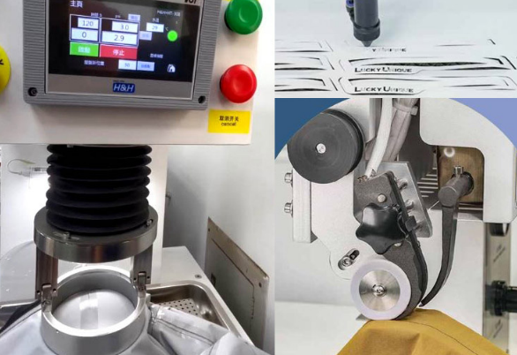
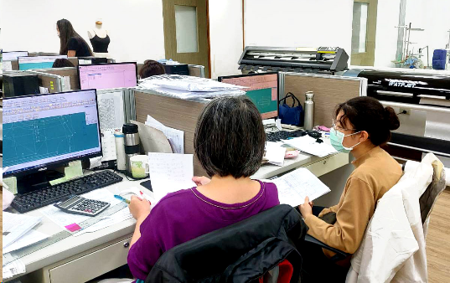
Garment R&D Center – Tainan
Rapid prototyping, efficient communication, stable quality, and reduced costs
Professional Center
Efficient Designer Team
Mass production prototyping
garment showroom
professional equipment
Pattern maker team

Slide 22
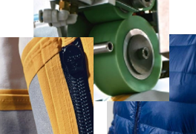
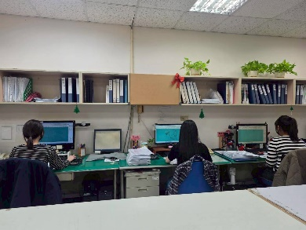
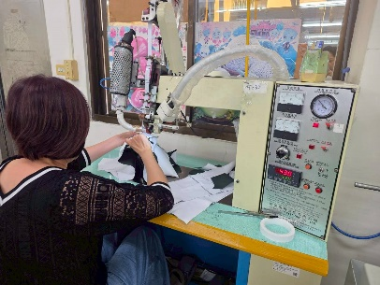
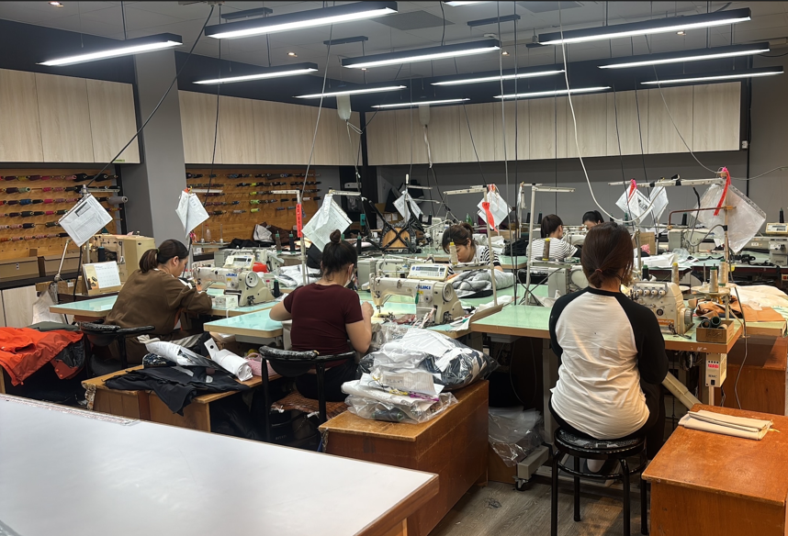
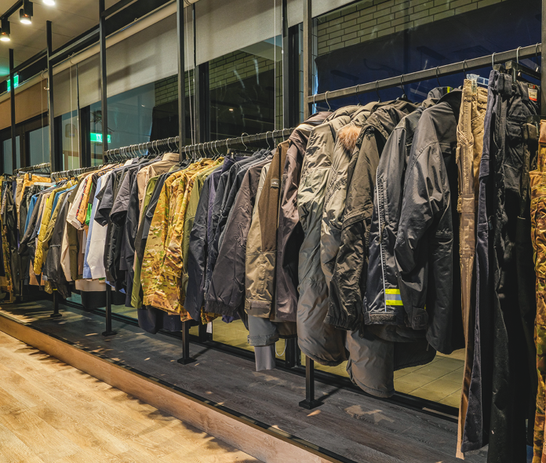
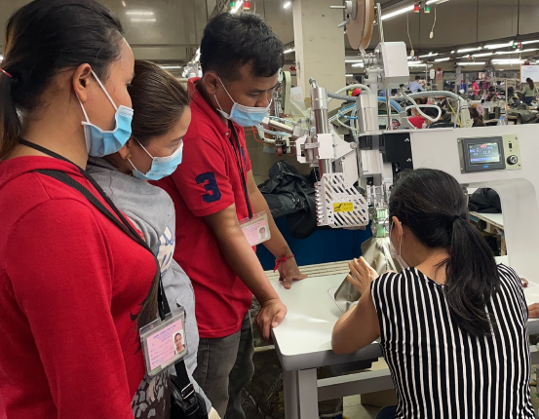
Garment R&D Center – W&D
New product development, rapid prototyping, sample sewing, and real-time response.
Mature Technology & Equipment
Pattern Maker Team
Professional Prototyping Engineers
Proofing & Mass Production
Dedicated Showroom
Immediate Improvement of
Development Issues

Slide 23
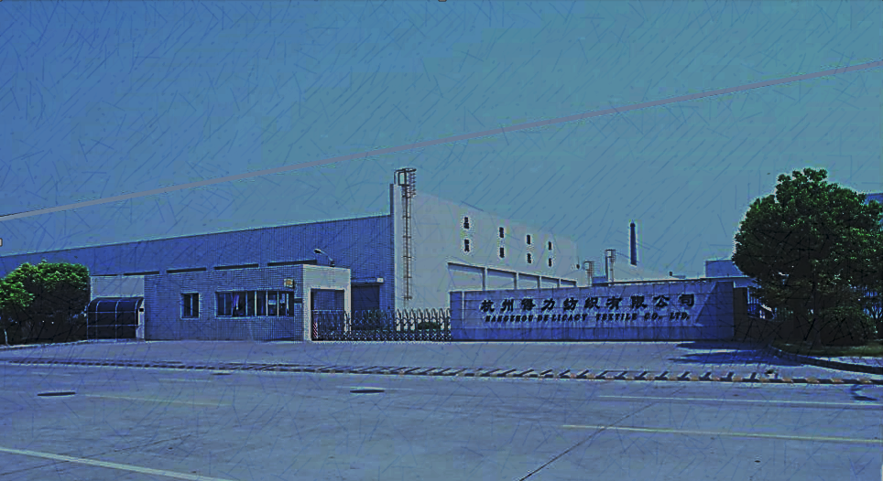
About De Licacy
Products
Financial Performance
Garment R&D Center
Relocation Compensation
Global capacity restructuring strategy in response to industrial changes
Partnership

Slide 24
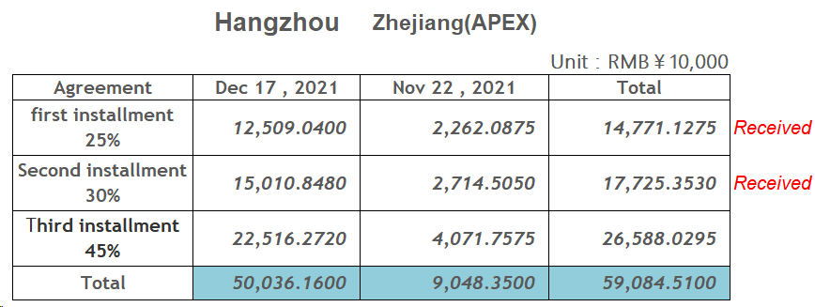
Relocation Compensation

Slide 25

About De Licacy
Products
Financial Performance
Garment R&D Center
Relocation Compensation
Global capacity restructuring strategy in response to industrial changes
Partnership

Slide 26

Global capacity restructuring strategy
in response to industrial changes
Taiwan Production Capacity Adjustment
(Structural Reduction)
To improve overall operational efficiency and capital utilization, the company is strategically adjusting its production capacity in Taiwan.
Short Fiber Business
Taiwan Deli Short Fiber Plant: Ceased operations
Garment Business
Taiwan Shanhua Garment Plant: Ceased mass production operations; the site has been transformed into a sampling and technical support center.
The Taiwan site will no longer focus on mass production, but will instead shift towards high value-added and key functional configurations.

Slide 27
Global capacity restructuring strategy
in response to industrial changes
Overseas production capacity expansion layout
In line with the needs of major customers and markets, the company is actively expanding its overseas production base:
The cloth industry
A new fabric factory in Indonesia as one of the main production bases in the medium and long term
A new yarn factory (False Twist factory) was established in mainland China to improve the stability of raw yarn (False Twist) supply within the group
The Garment industry
The construction of the SHANHUA Garment factory in Cambodia is completed, and the production capacity can already support the growth of subsequent orders

Slide 28

Global capacity restructuring strategy
in response to industrial changes
Key Considerations for Taiwan's Capacity Reduction:
Rising costs of labor, energy, and regulatory compliance;
Taiwan's production environment is unfavorable for large-scale, labor-intensive processes;
Focus on high value-added, critical processes and R&D activities;
Responding to customer demands for supply chain resilience and regional diversification.

Slide 29

Global capacity restructuring strategy
in response to industrial changes
Transformation and Positioning of the Taiwan Base
Taiwan is transforming from a traditional mass production base into the core hub of the company's overall operations:
R&D prototyping and new product technology introduction
Advanced process and quality management
Global supply chain management and operational decision-making center
Strengthening the depth of technical cooperation with customers

Slide 30
Global capacity restructuring strategy
in response to industrial changes
The strategic goals of overseas expansion are:
Establish a multi-regional production capacity layout to mitigate geopolitical and operational risks;
Be close to major customers' production bases to shorten delivery times and improve responsiveness;
Leverage cost and scale advantages to enhance price competitiveness;
Support future order growth and new customer development.

Slide 31

About De Licacy
Products
Financial Performance
Garment R&D Center
Relocation Compensation
Global capacity restructuring strategy in response to industrial changes
Partnership

Slide 32













SUPPLIERS (Fabric)

Slide 33





















































OUR CUSTOMERS (Fabric)

Slide 34


















OUR CUSTOMERS (Garment)

Slide 35
Thank You!

