Slide 1


Investor Update
Jun 23, 2026
http://www.delicacy.com.tw

Slide 2
Disclaimer
The information contained in this presentation, including all forward-looking information, is subject to change without notice, whether as a result of new information, future events or otherwise, and De Licacy Co., Ltd. (the “Company”) undertakes no obligation to update or revise the information contained in this presentation. No representation or warranty, either expressed or implied, is provided in relation to the accuracy, completeness or reliability of the information contained herein, nor is the information intended to be a complete statement of the Company, markets or developments referred to in this presentation.

Slide 3
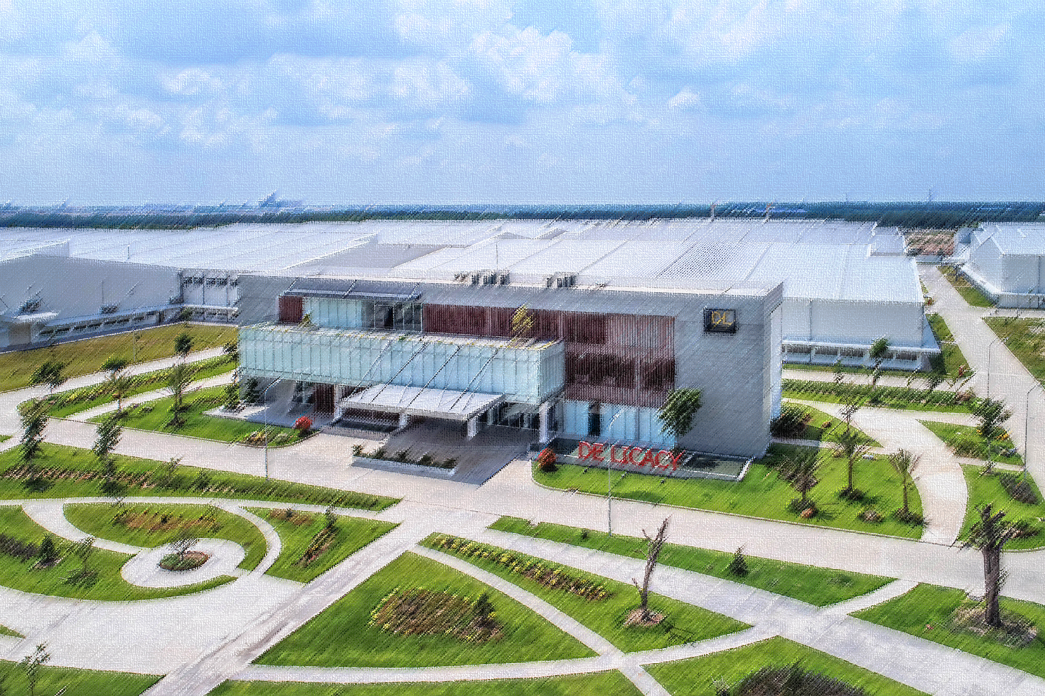
About De Licacy
Products
Financial Performance
Relocation Compensation
Partnership
OUTLINE

Slide 4
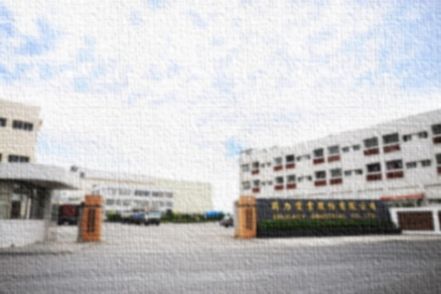
ABOUT DE LICACY
Products
Financial Performance
Relocation Compensation
Partnership

Slide 5



HISTORY
Established office in Taipei
Established factory in Hangzhou
joined the bluesign®
SYSTEM
1982
1987
1997
1998
1999
2012
Taiwan De Licacy was founded in summer
Shares were traded in Taiwan Stock Market in January
Coating & Lamination extra finishing factory was established

Slide 6

HISTORY
Acquired future tycoon Corporate Groups
Established APEX (ANHUI) New Material Co., Ltd.
Passed ISO 14001
Environmental Management System Verification
Golden Trade Award for Best Trade Contribution Award
Established Apex (Anqing) TEXTILE CO.,LTD
2017
2018
2021
2022
2023
2025
2026
Received GRS
certification
Acquired LUCKY Corporate Groups in January
Paid deposit for Indonesian factory land in October
Established factory in Nantong

Slide 7
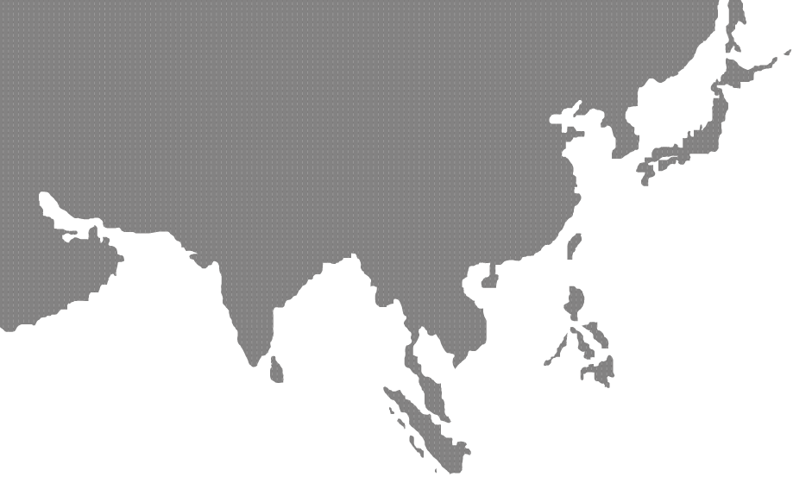
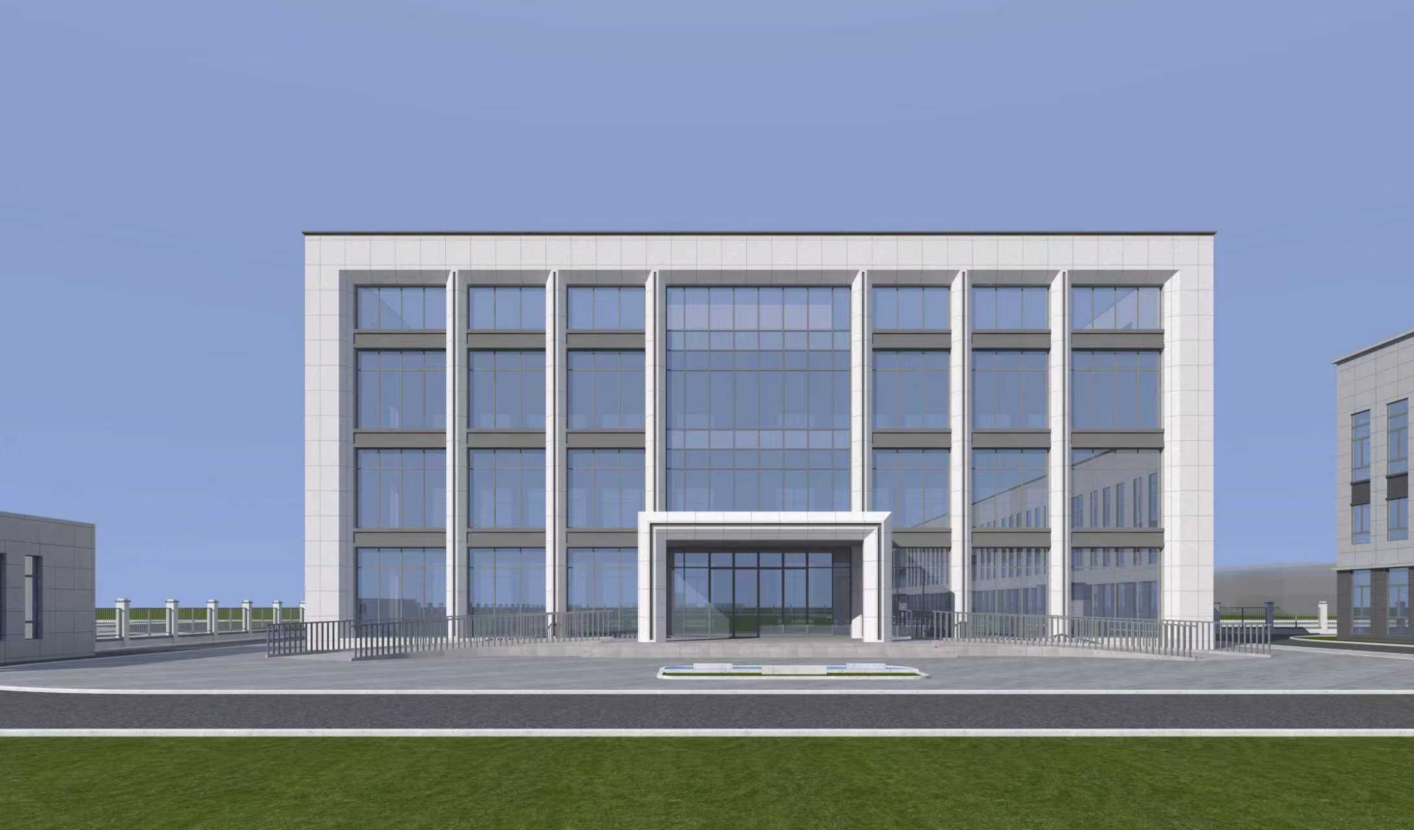
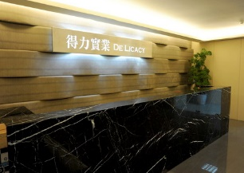
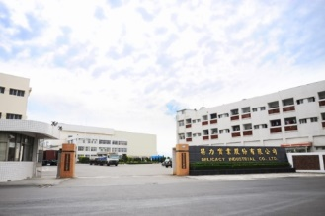
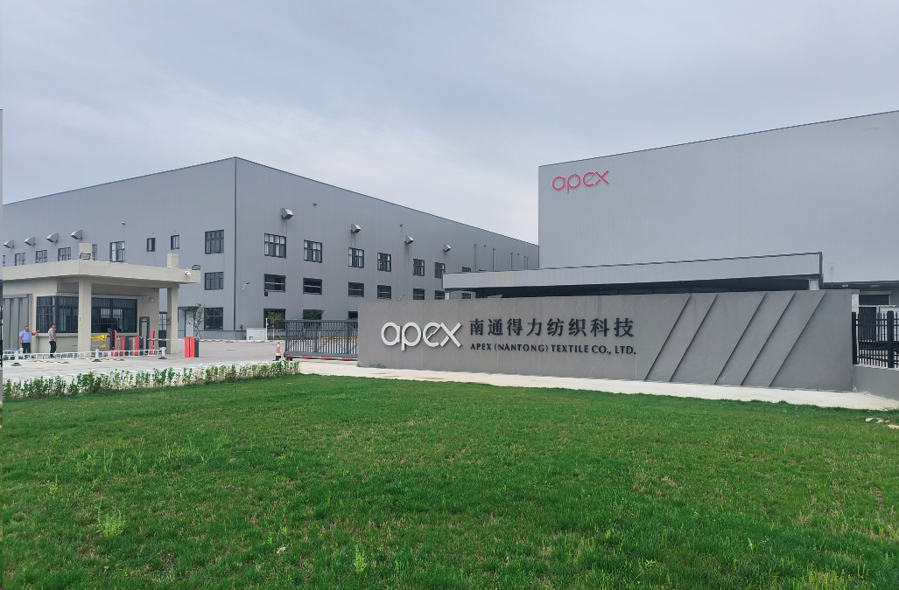
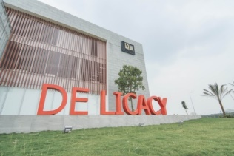
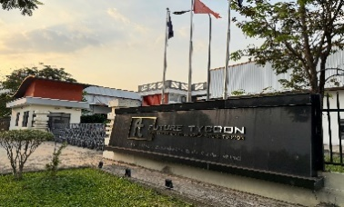
LOCATION
Factory
Anhui,
CHINA
Sales Office
Factory
Factory
Factory
Factory
Taipei, TAIWAN
Tainan, TAIWAN
Ho Chi Minh City,
VIETNAM
Dong Nai Province,
VIETNAM
Jiangsu,
CHINA

Slide 8
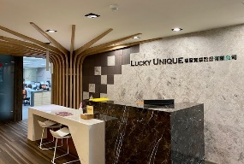
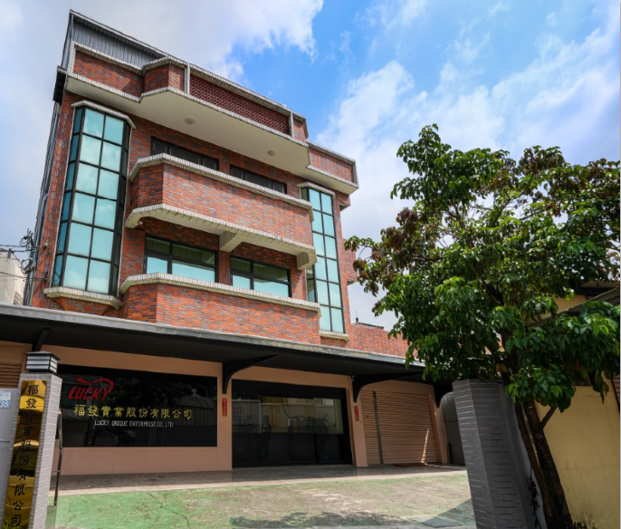
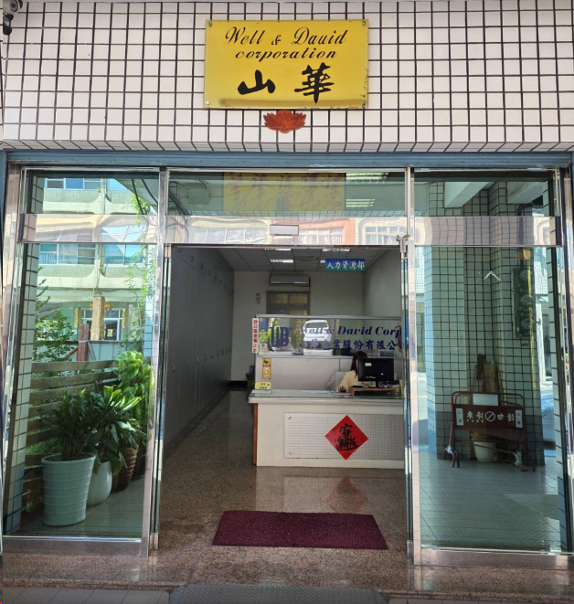
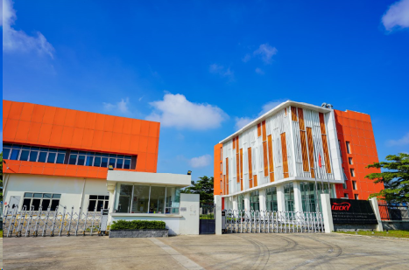
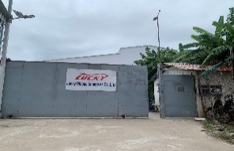
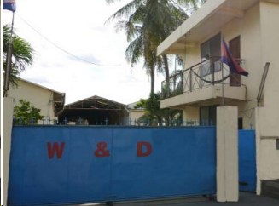
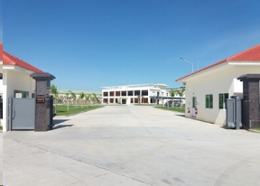
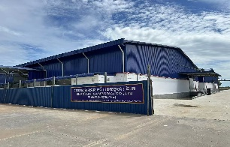
LOCATION
Sales Office
Garment R&D
Center W&D
Garment R&D
Center Tainan
Taipei, TAIWAN
Kaohsiung, TAIWAN
Tainan, TAIWAN
Garment Factory
Lucky VN
Binh Phuoc
Prov.,
VIETNAM
Garment Factory
W&D
Garment Factory
SHANHUA
Garment Factory
Lucky
Garment Factory
Li Qiang
Kandal
Prov.,
Cambodia
Phnom Penh
Prov.,
Cambodia
Kampong Cham Prov.,
Cambodia
Kampong Cham Prov.,
Cambodia

Slide 9
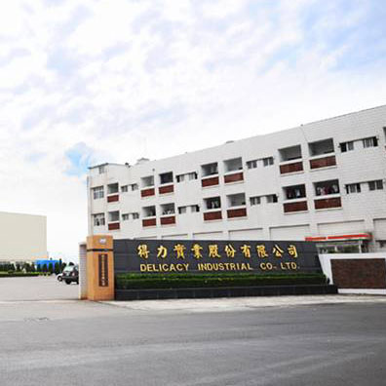
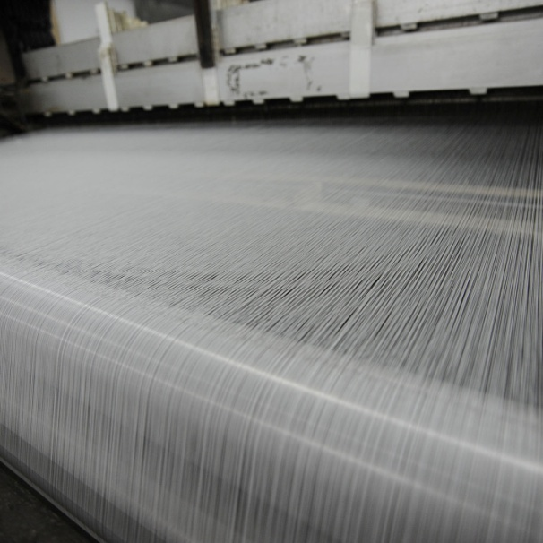
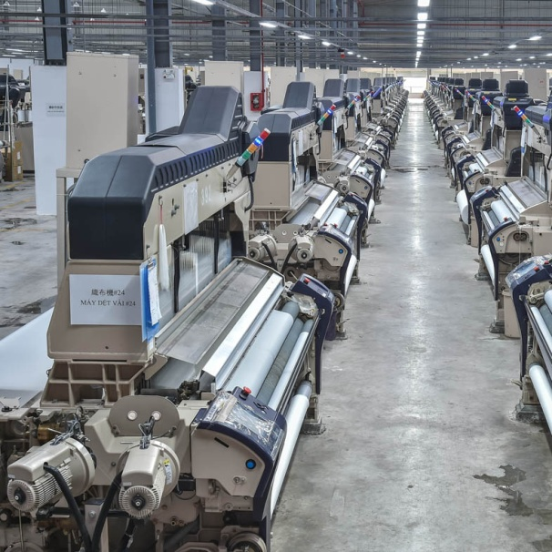
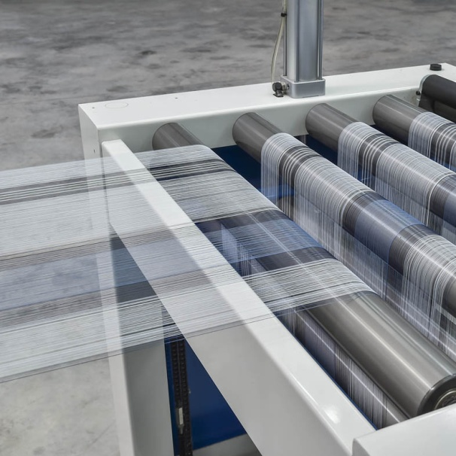
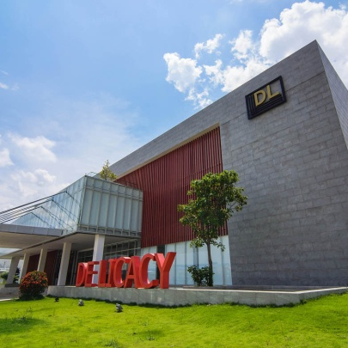
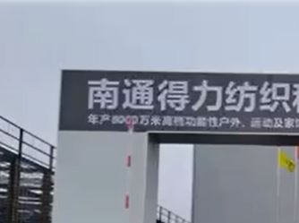
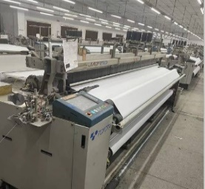
CAPACITY ADJUSTMENT
P/D
2,100,000
yard/month
Tainan
Factory
P/D
5,200,000
yard/month
Y/D
1,200,000
yard/month
Vietnam
De Licacy
P/D
2,500,000
yard/month
Nantong
Factory

Slide 10
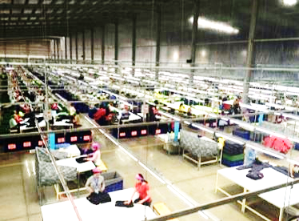
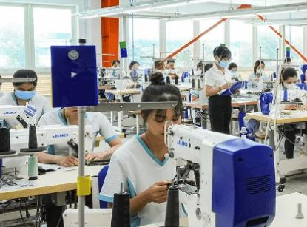
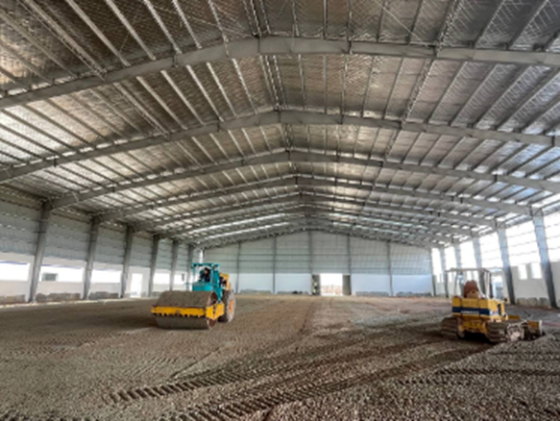
CAPACITY ADJUSTMENT
170,000
pieces/month
100,000
pieces/month
Factory Lucky VN
Factory W&D Cambodia
120,000
pieces/month
178,000
pieces/month
Factory GTA Cambodia
Factory Li Qiang Cambodia
150,000
pieces/month
Factory SHANHUA Cambodia

Slide 11
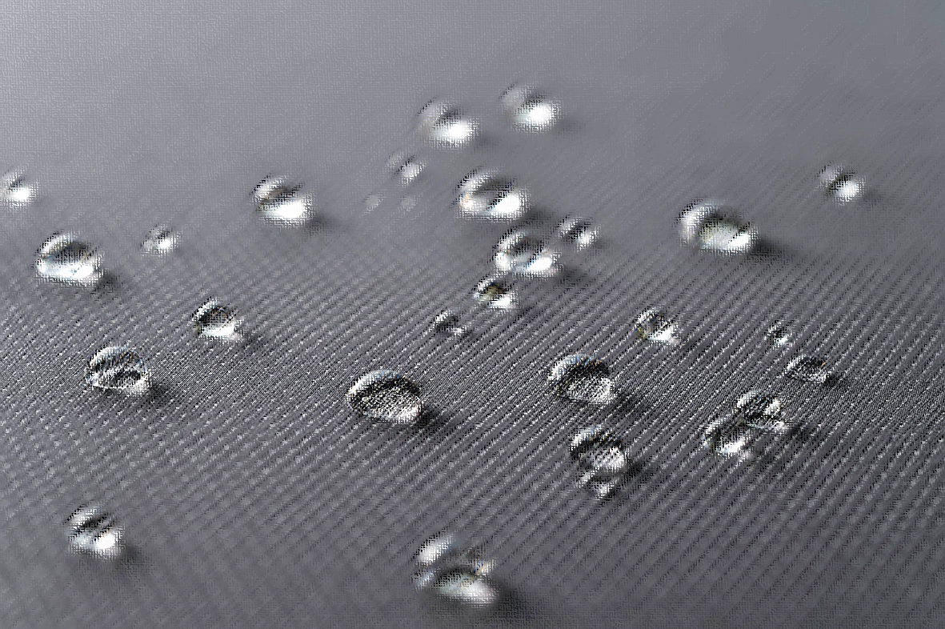
About De Licacy
PRODUCTS
Financial Performance
Relocation Compensation
Partnership

Slide 12

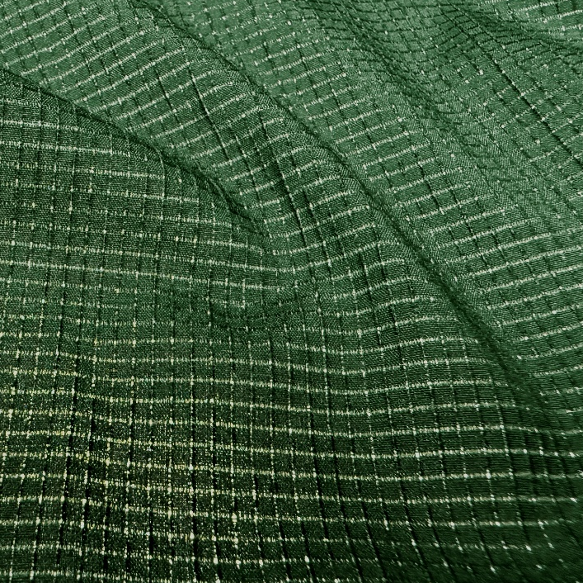
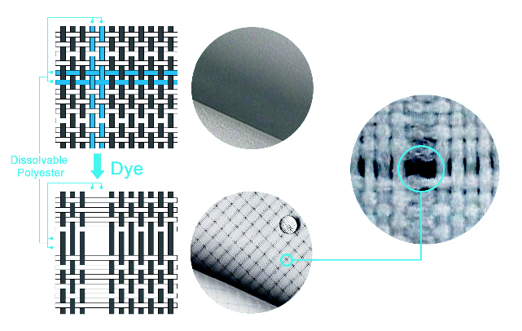
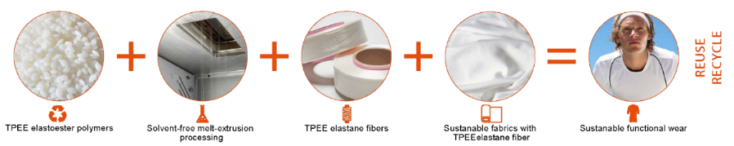
Thermoplastic Polyester Elastomer + AERO-TECH
TPEE is a recyclable alternative to conventional stretch fibers, enabling mono-material polyester fabrics for easier recycling. With low heat-set requirements, excellent stretch recovery, softness, and improved colorfastness, it is paired with AERO-TECH soluble yarn to create breathable micro-ventilation and customizable airflow patterns for a fully recyclable performance fabric.

Slide 13
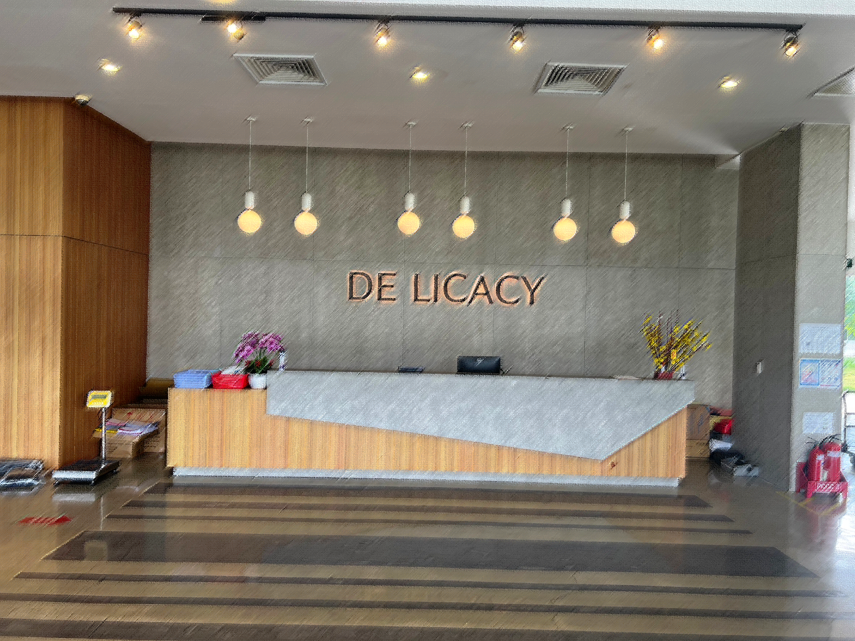
About De Licacy
Products
Financial Performance
Relocation Compensation
Partnership

Slide 14
Profitability
Total Revenue (NT$B)
Net Profit Margin (%)

Slide 15
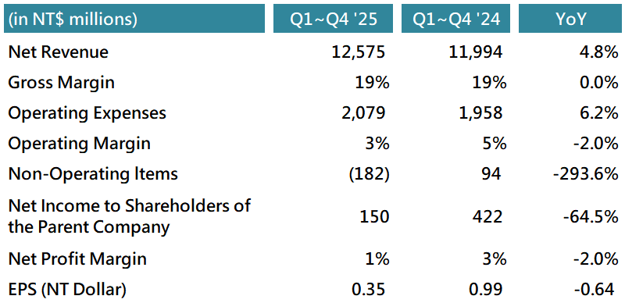
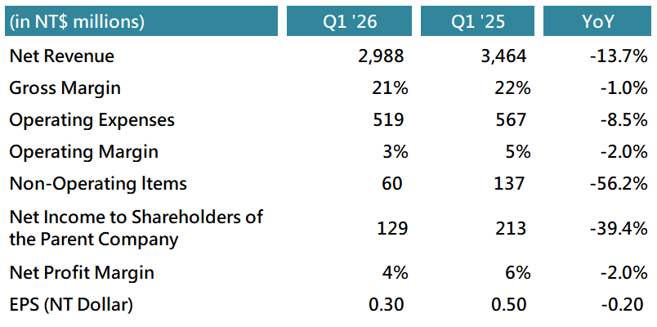
Consolidated P&L

Slide 16
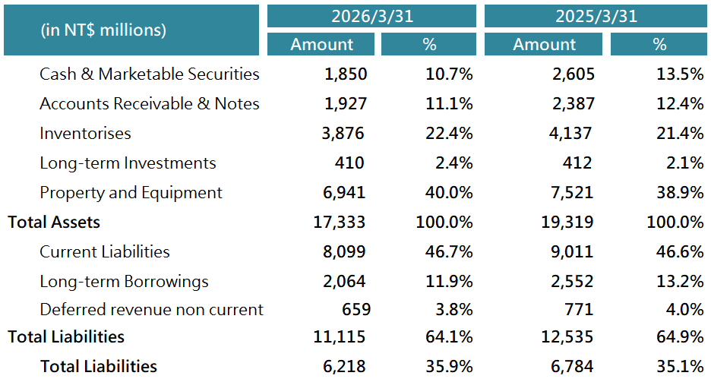
Consolidated Balance Sheets

Slide 17
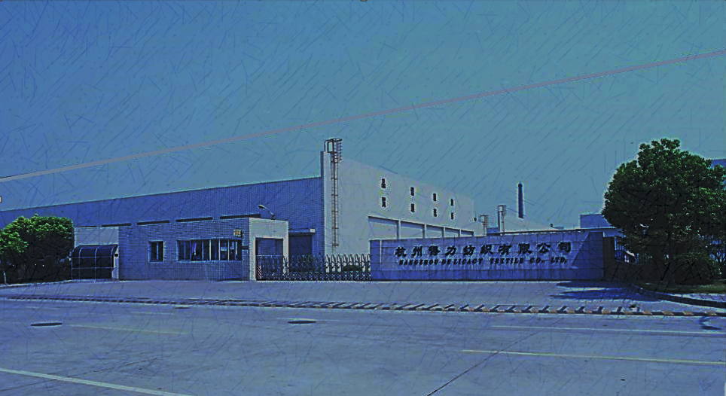
About De Licacy
Products
Financial Performance
Relocation Compensation
Partnership

Slide 18
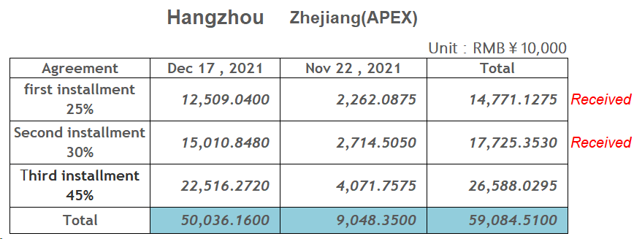
Relocation Compensation

Slide 19
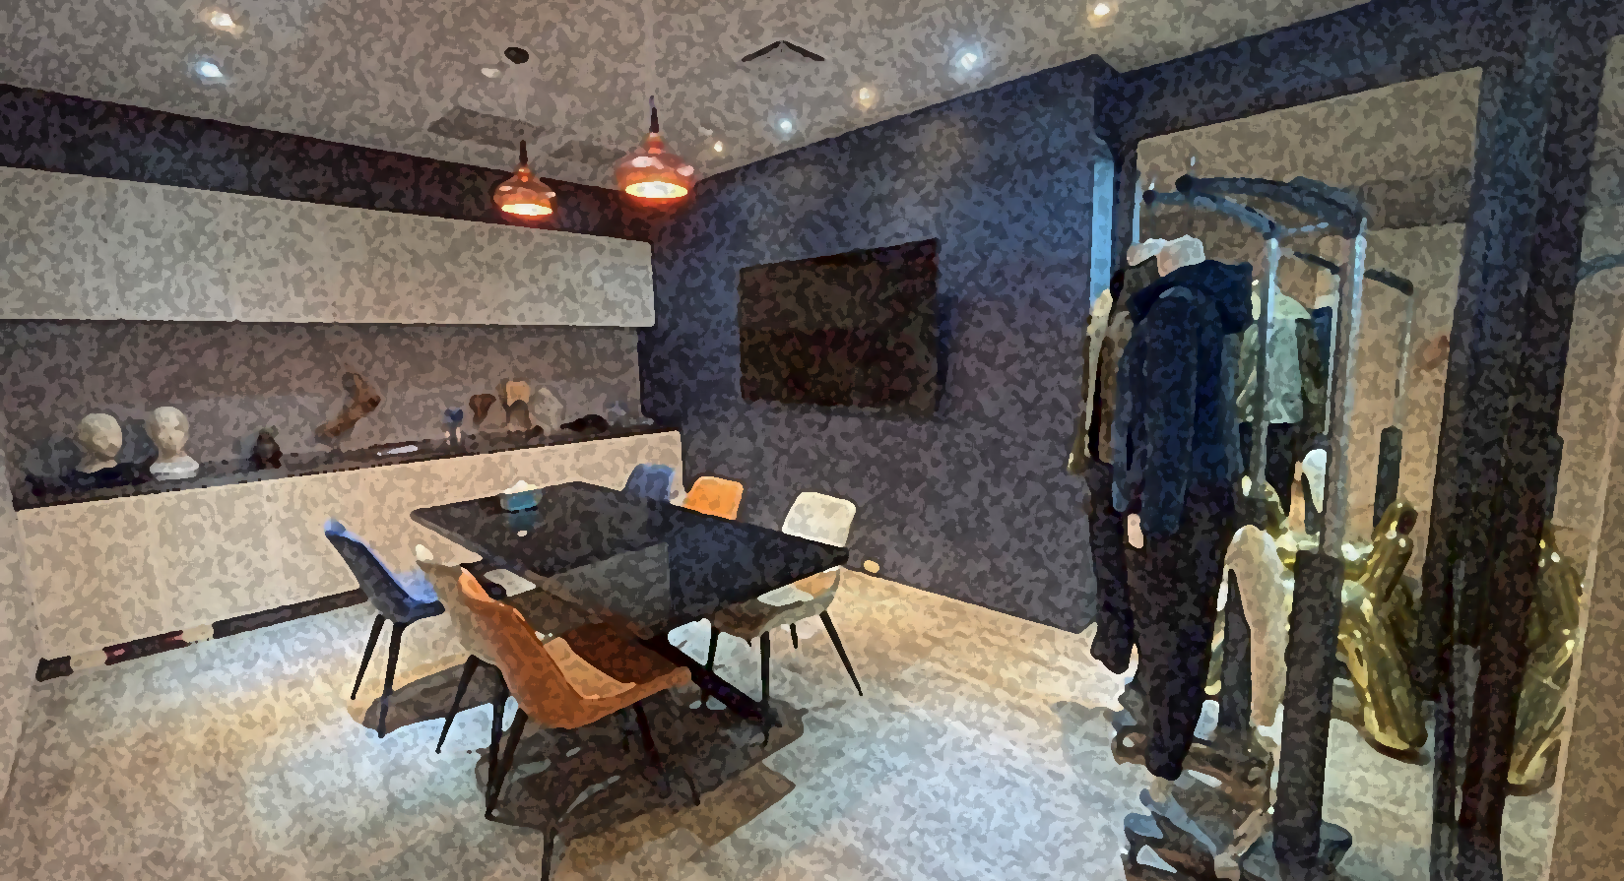
About De Licacy
Products
Financial Performance
Relocation Compensation
Partnership

Slide 20













SUPPLIERS (Fabric)

Slide 21















































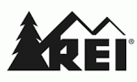








OUR CUSTOMERS (Fabric)

Slide 22






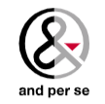











OUR CUSTOMERS (Garment)

Slide 23
Thank You!

