Slide 1


Investor Update
Sep 15, 2026
http://www.delicacy.com.tw

Slide 2
Disclaimer
The information contained in this presentation, including all forward-looking information, is subject to change without notice, whether as a result of new information, future events or otherwise, and De Licacy Co., Ltd. (the “Company”) undertakes no obligation to update or revise the information contained in this presentation. No representation or warranty, either expressed or implied, is provided in relation to the accuracy, completeness or reliability of the information contained herein, nor is the information intended to be a complete statement of the Company, markets or developments referred to in this presentation.

Slide 3
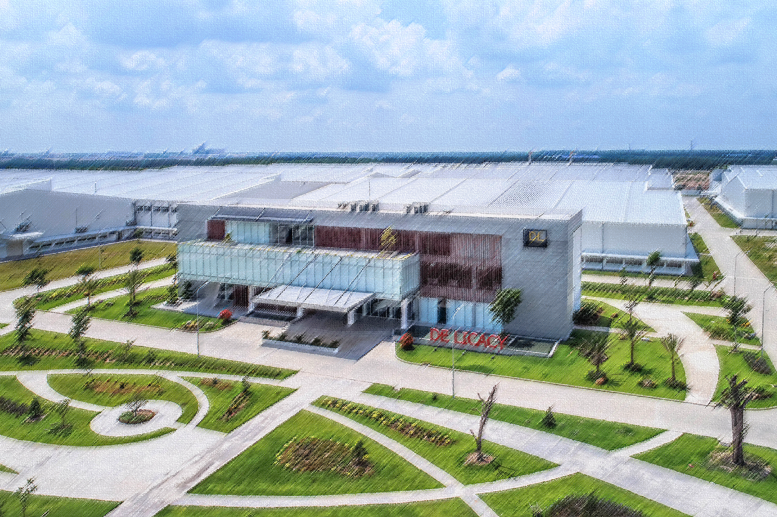
About De Licacy
Products
Financial Performance
Construction Progress APEX (ANHUI) Co.,
Relocation Compensation
Business Outlook
Partnership
OUTLINE

Slide 4
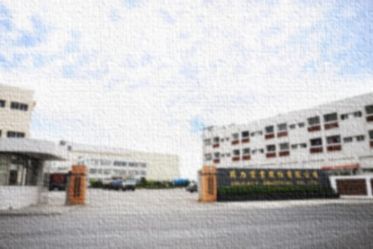
ABOUT DE LICACY
Products
Financial Performance
Construction Progress APEX (ANHUI) Co.,
Relocation Compensation
Business Outlook
Partnership

Slide 5



HISTORY
Established office in Taipei
Established factory in Hangzhou
joined the bluesign®
SYSTEM
1982
1987
1997
1998
1999
2012
Taiwan De Licacy was founded in summer
Shares were traded in Taiwan Stock Market in January
Coating & Lamination extra finishing factory was established

Slide 6

HISTORY
Acquired future tycoon Corporate Groups
Established APEX (ANHUI) New Material Co., Ltd.
Passed ISO 14001
Environmental Management System Verification
Golden Trade Award for Best Trade Contribution Award
Established Apex (Anqing) TEXTILE CO.,LTD
2017
2018
2021
2022
2023
2025
2026
Received GRS
certification
Acquired LUCKY Corporate Groups in January
Paid deposit for Indonesian factory land in October
Established factory in Nantong

Slide 7

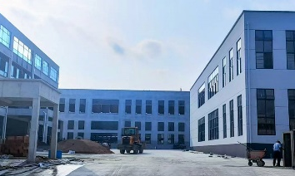
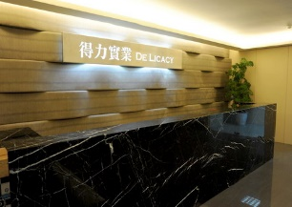
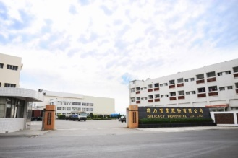
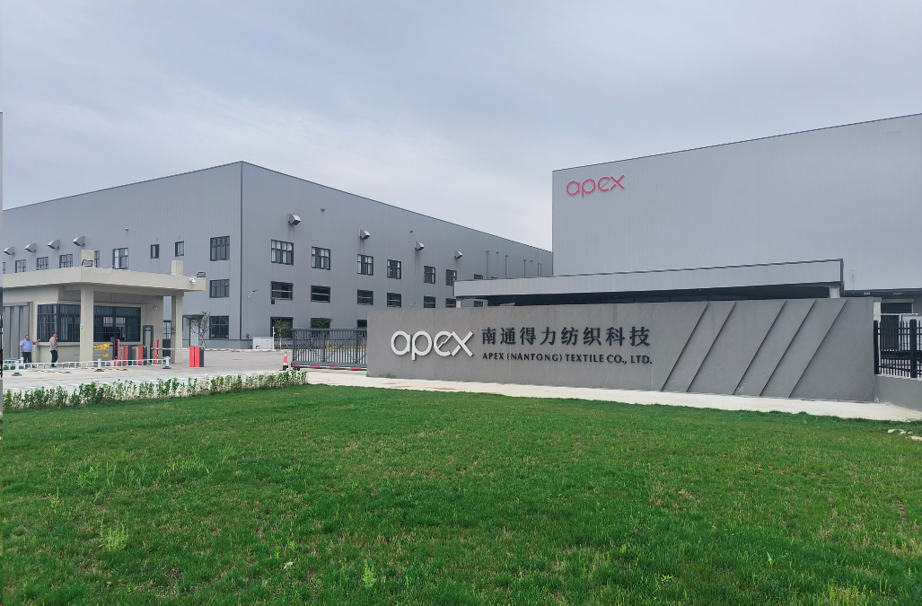
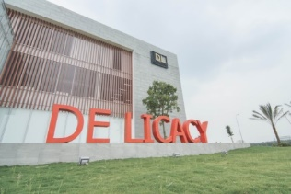
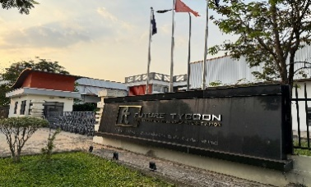
LOCATION
Factory
Anhui,
CHINA
Sales Office
Factory
Factory
Factory
Factory
Taipei, TAIWAN
Tainan, TAIWAN
Ho Chi Minh City,
VIETNAM
Dong Nai Province,
VIETNAM
Jiangsu,
CHINA

Slide 8
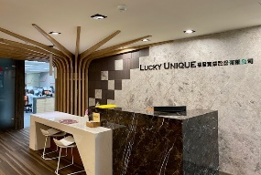
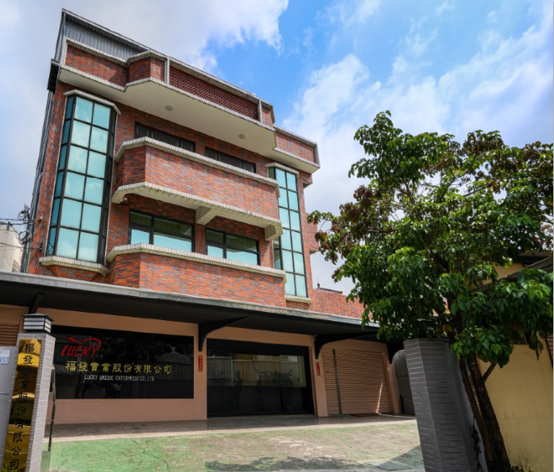
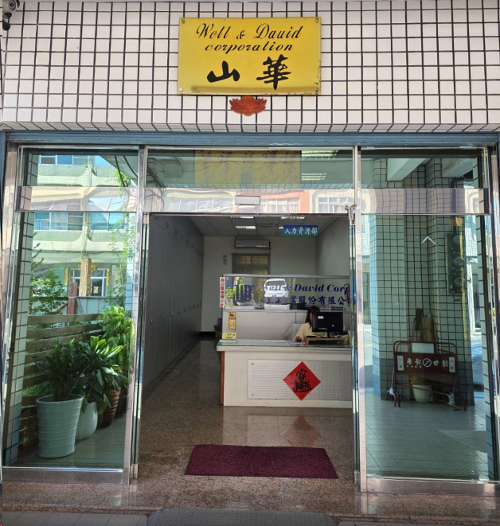
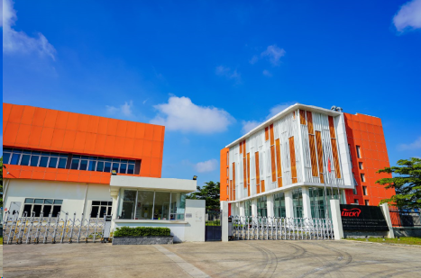
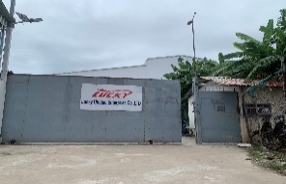
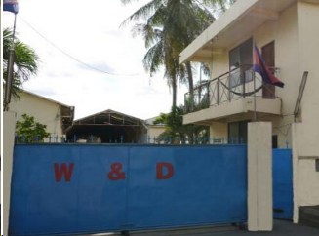
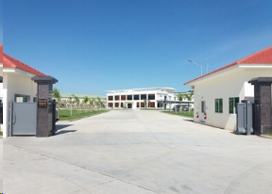
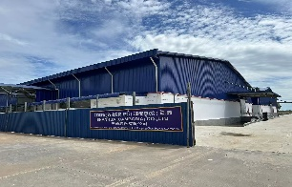
LOCATION
Sales Office
Garment R&D
Center W&D
Garment R&D
Center Tainan
Taipei, TAIWAN
Kaohsiung, TAIWAN
Tainan, TAIWAN
Garment Factory
Lucky VN
Binh Phuoc
Prov.,
VIETNAM
Garment Factory
W&D
Garment Factory
SHANHUA
Garment Factory
Lucky
Garment Factory
Li Qiang
Kandal
Prov.,
Cambodia
Phnom Penh
Prov.,
Cambodia
Kampong Cham Prov.,
Cambodia
Kampong Cham Prov.,
Cambodia

Slide 9
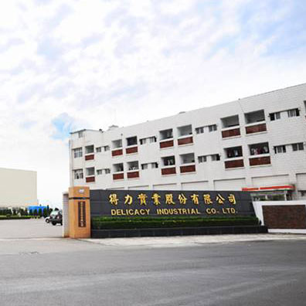
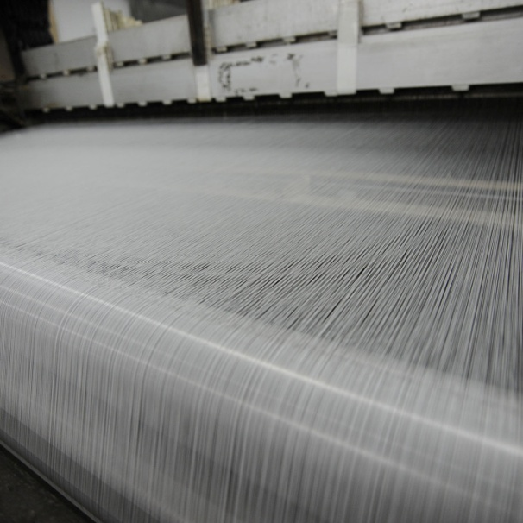
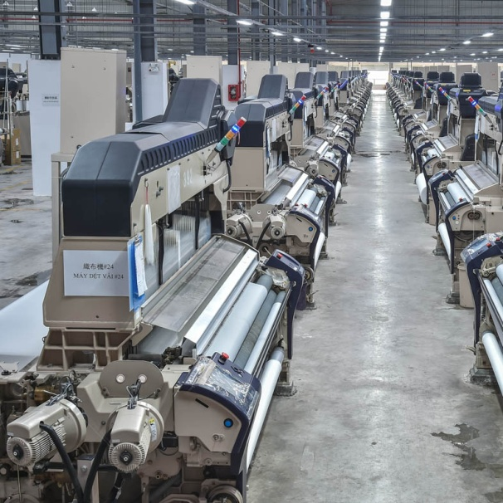
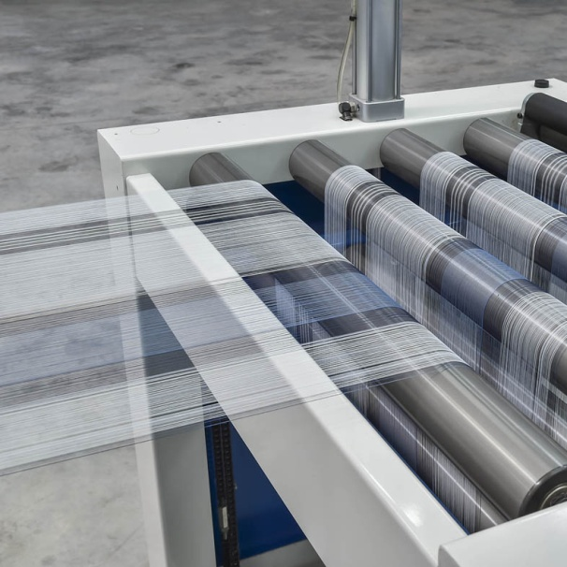
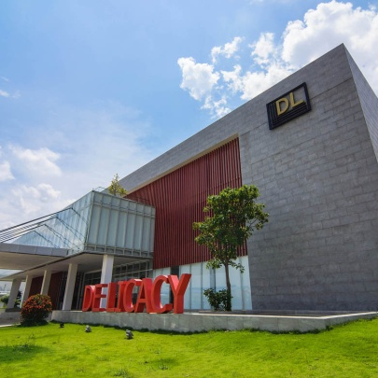
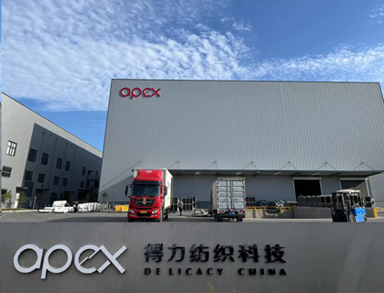
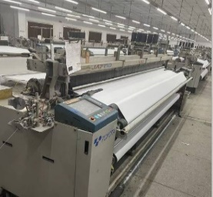
CAPACITY ADJUSTMENT
P/D
2,100,000
yard/month
Tainan
Factory
P/D
5,200,000
yard/month
Y/D
1,200,000
yard/month
Vietnam
De Licacy
P/D
2,500,000
yard/month
Nantong
Factory

Slide 10
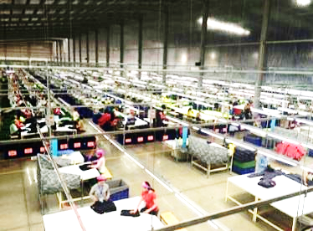
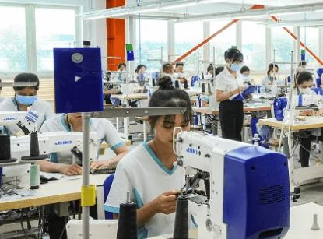
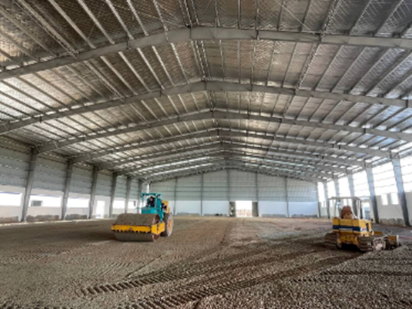
CAPACITY ADJUSTMENT
170,000
pieces/month
100,000
pieces/month
Factory Lucky VN
Factory W&D Cambodia
120,000
pieces/month
178,000
pieces/month
Factory GTA Cambodia
Factory Li Qiang Cambodia
150,000
pieces/month
Factory SHANHUA Cambodia

Slide 11

About De Licacy
PRODUCTS
Financial Performance
Construction Progress APEX (ANHUI) Co.,
Relocation Compensation
Business Outlook
Partnership

Slide 12

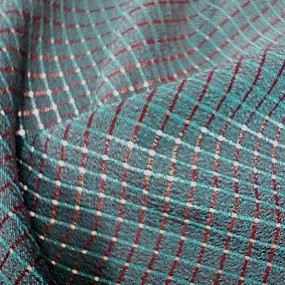
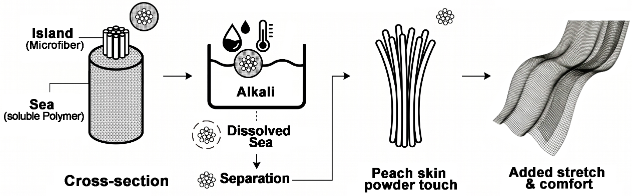
PEACHLUX-FLEX+ AERO-TECH
Island-in-Sea technology creates ultra-fine microfibers with a soft, powdery suede-like hand. Contrasting warp and weft colors deliver a dynamic iridescent effect that shifts with movement and viewing angle., it is paired with AERO-TECH soluble yarn to create breathable micro-ventilation and customizable airflow patterns for a fully recyclable performance fabric.

Slide 13
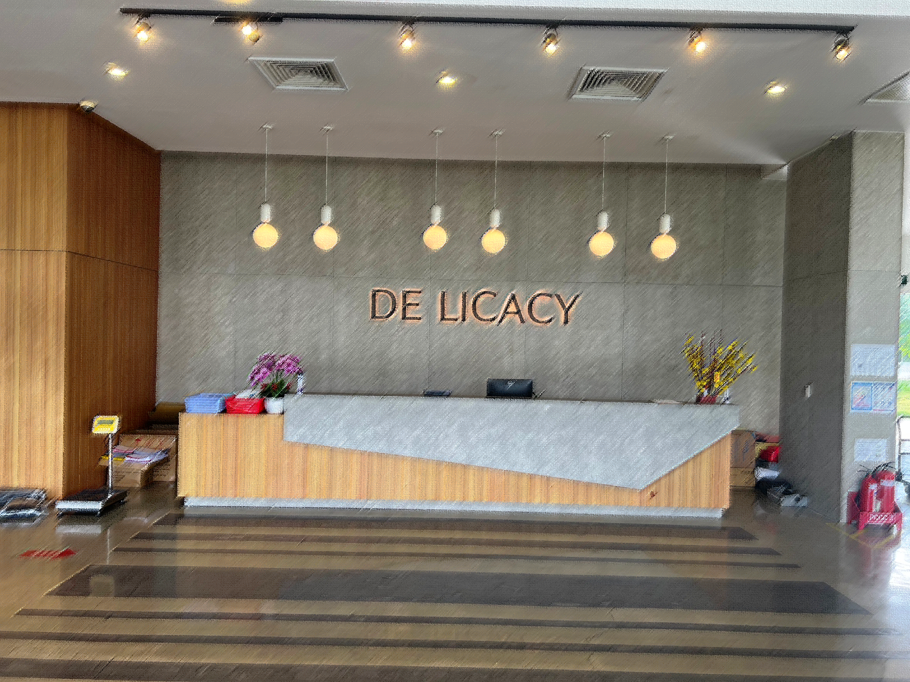
About De Licacy
Products
Financial Performance
Construction Progress APEX (ANHUI) Co.,
Relocation Compensation
Business Outlook
Partnership

Slide 14
Profitability
Total Revenue (NT$B)
Net Profit Margin (%)

Slide 15
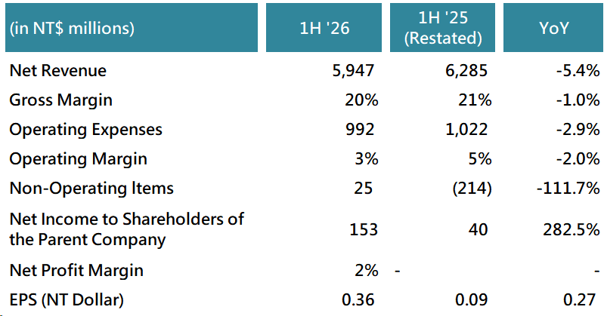
Consolidated P&L

Slide 16
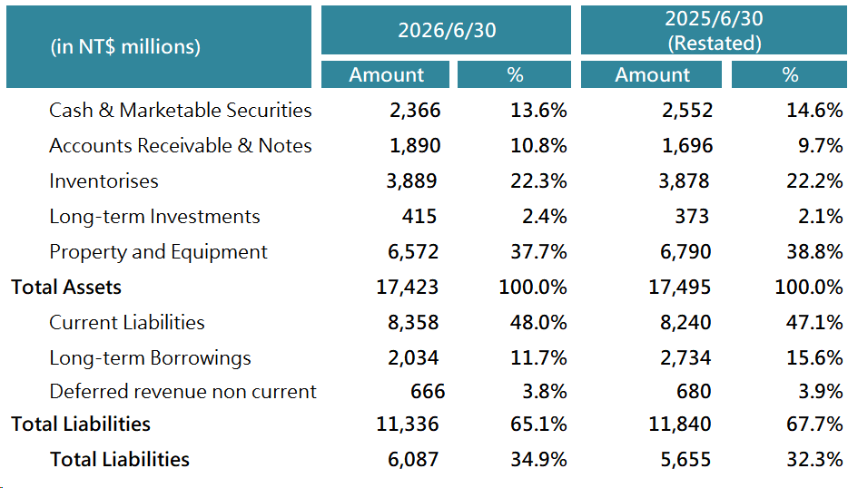
Consolidated Balance Sheets

Slide 17

About De Licacy
Products
Financial Performance
Construction Progress
APEX (ANHUI) Co.,
Relocation Compensation
Business Outlook
Partnership

Slide 18
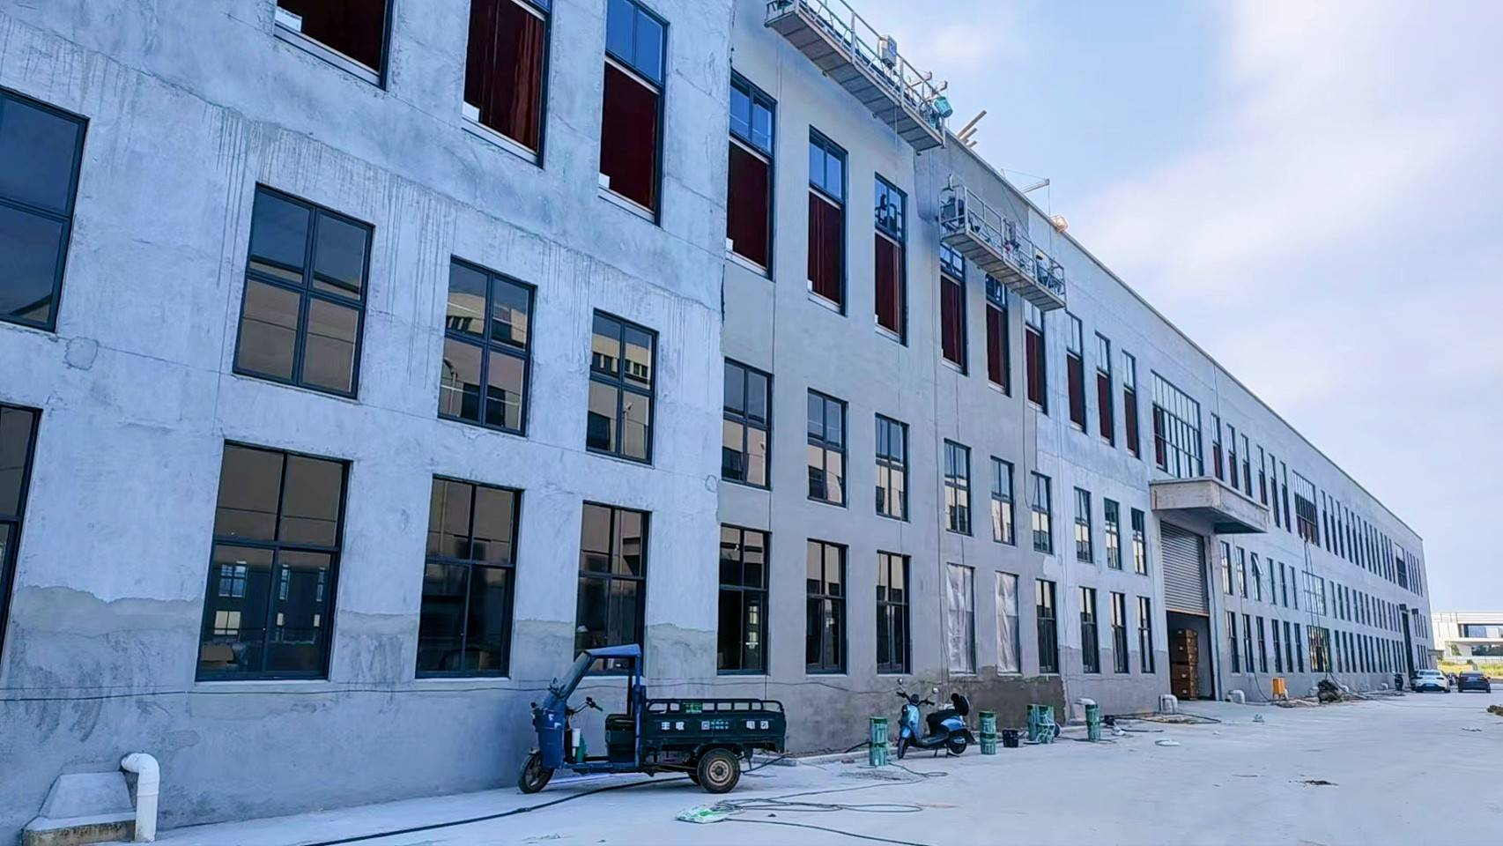
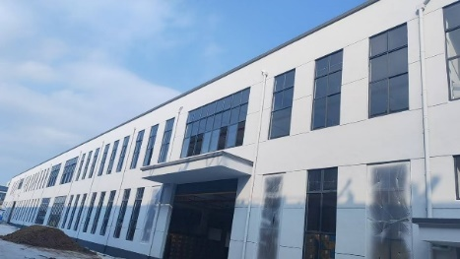
Construction Progress
Investment amount: US$3 million
Leased factory premises
Production started in August 2026
Full production expected in November
Estimated monthly production of false twist yarn: 261 tons

Slide 19
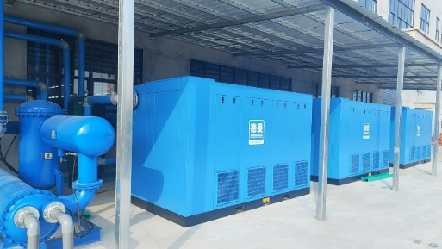
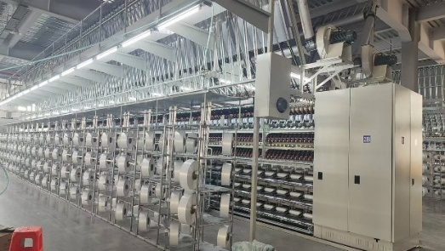
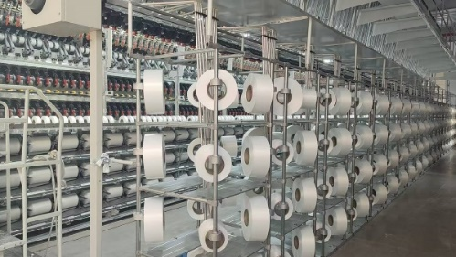
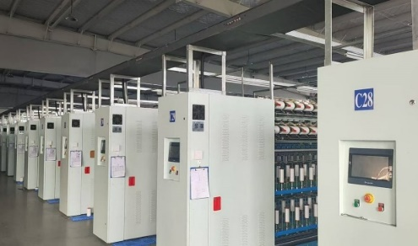
Construction Progress
Air compressor system
Mechanical coating machine:
Capacity 81 tons/month
Air coating machine:
Capacity 180 tons/month

Slide 20
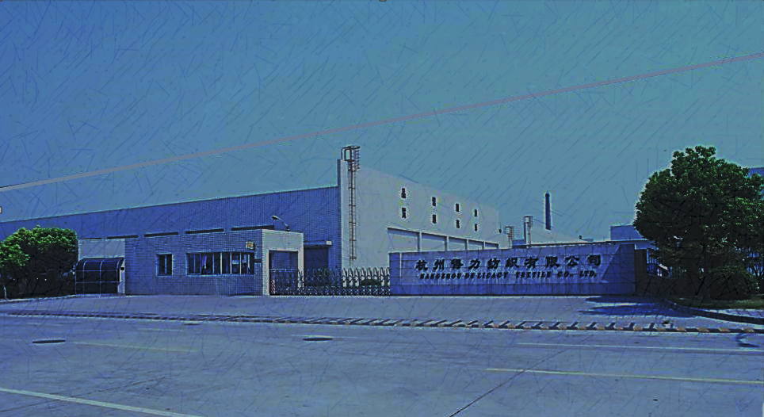
About De Licacy
Products
Financial Performance
Construction Progress APEX (ANHUI) Co.,
Relocation Compensation
Business Outlook
Partnership

Slide 21
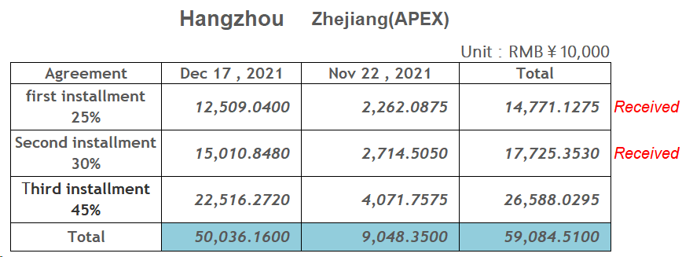
Relocation Compensation

Slide 22
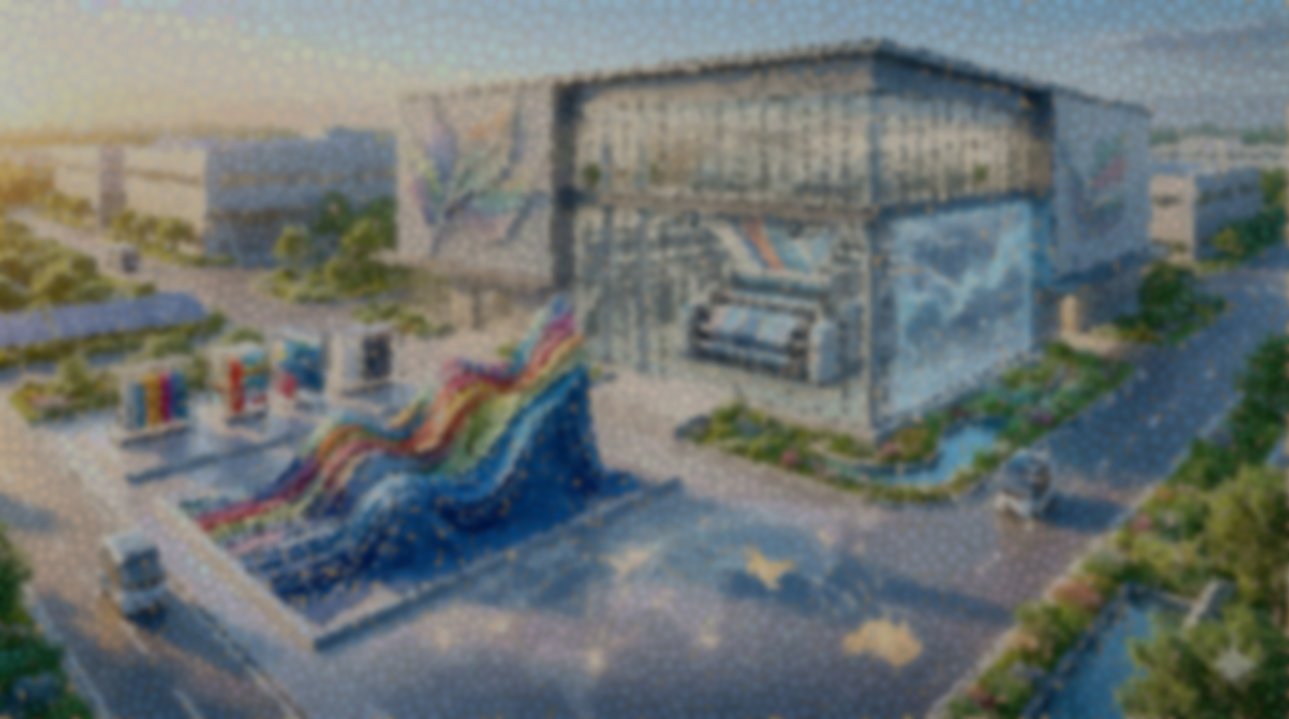
About De Licacy
Products
Financial Performance
Construction Progress APEX (ANHUI) Co.,
Relocation Compensation
Business Outlook
Partnership

Slide 23
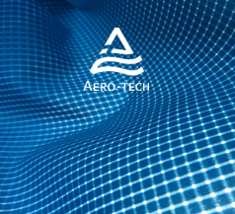


Business Outlook
Demand Recovery
Brand customer inventory is gradually returning to healthy levels, and demand for goods is beginning to recover, driving overall operational improvement.
Customer Expansion
Continuously developing new brand customers and expanding into overseas markets such as India, Australia, and Europe.
Emerging Market Strategy
Continuously cultivating the sports and fitness market and actively engaging with emerging brands to create future growth opportunities.

Slide 24
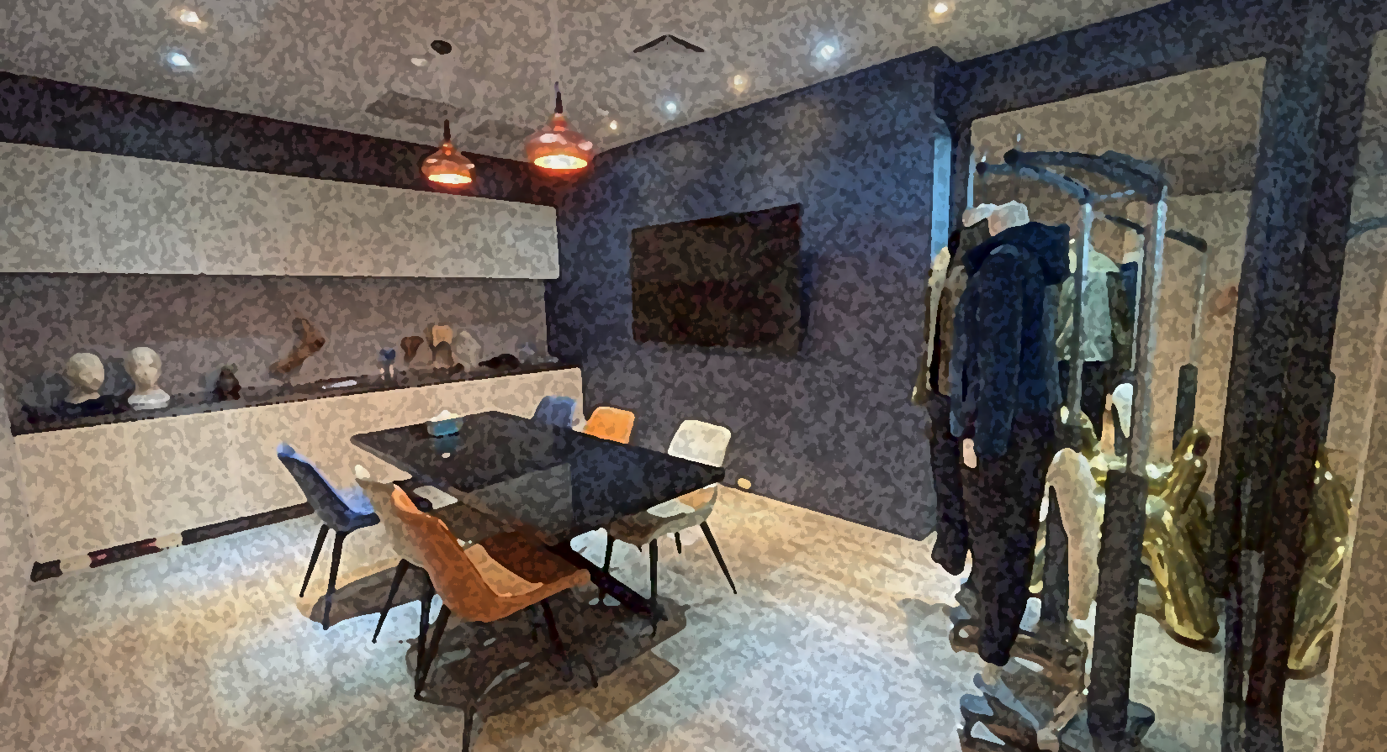
About De Licacy
Products
Financial Performance
Construction Progress APEX (ANHUI) Co.,
Relocation Compensation
Business Outlook
Partnership

Slide 25













SUPPLIERS (Fabric)

Slide 26







































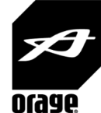







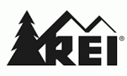








OUR CUSTOMERS (Fabric)

Slide 27






























OUR CUSTOMERS (Garment)

Slide 28
Thank You!

